Slide 1
QuantTree EWMA
Report of Results

Slide 2
Experiments Performed:
Small Change
Weekday Only
Weekend Only
Mixed (70% Weekday and 30% Weekend)
Medium Change
Weekday Only
Weekend Only
Mixed (70% Weekday and 30% Weekend)
Big Change
Weekday Only
Weekend Only
Mixed (70% Weekday and 30% Weekend)
Actuated Change
Weekday Only
Weekend Only
Mixed (70% Weekday and 30% Weekend)

Slide 3
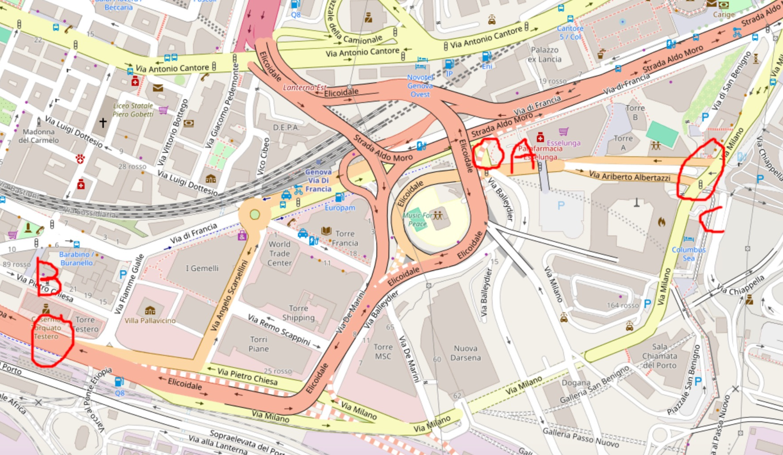
Experiments Performed:
Small Change
only traffic light A is changed.
Medium Change
change it's A and B
Big Change
Change is in A, B and C.
Actuated Change
Change is in A and B.

Slide 4
Generating Sequences
Explanation on how the training data and sequences are generated
In all the runs of the simulator, it was used Poisson inflows (probably the best compromise between realism and non-Gaussianity)

Slide 5
Sequence Generation (1/2) - Inputs
Scenario 0
d
Φ₀
s
For each iteration of the experiments (each time we run quantree), we shuffles the indexes of these vectors, from which we generate the sequences (next slide).
Scenario 1
d
Φ₁
s
d is the number of dimensions/variables
s is the number of samples/days
Φ₀ is the distribution of scenario 0
Φ₁ is the distribution of scenario 1

Slide 6
Sequence Generation (2/2) - Outputs
N
m - N
d
Φ₀
Φ₀
Sequence 0 (no change and non overlapping with training data)
Training data
(same for both sequences)
Sequence 1 (with change)
d
Φ₁
m
N is the moment where the change happens, from which we start to monitor on QuanTree EWMA.
d is the number of dimensions/variables in the sequence
m is the number of samples/days
Φ₀ is the distribution of scenario 0
Φ₁ is the distribution of scenario 1

Slide 7
Sanity Check
Artificially generated data to check implementation
Scenario 0 → Scenario 1
The distribution under Scenario 0 is gaussian and under Scenario 1 is poisson.

Slide 8
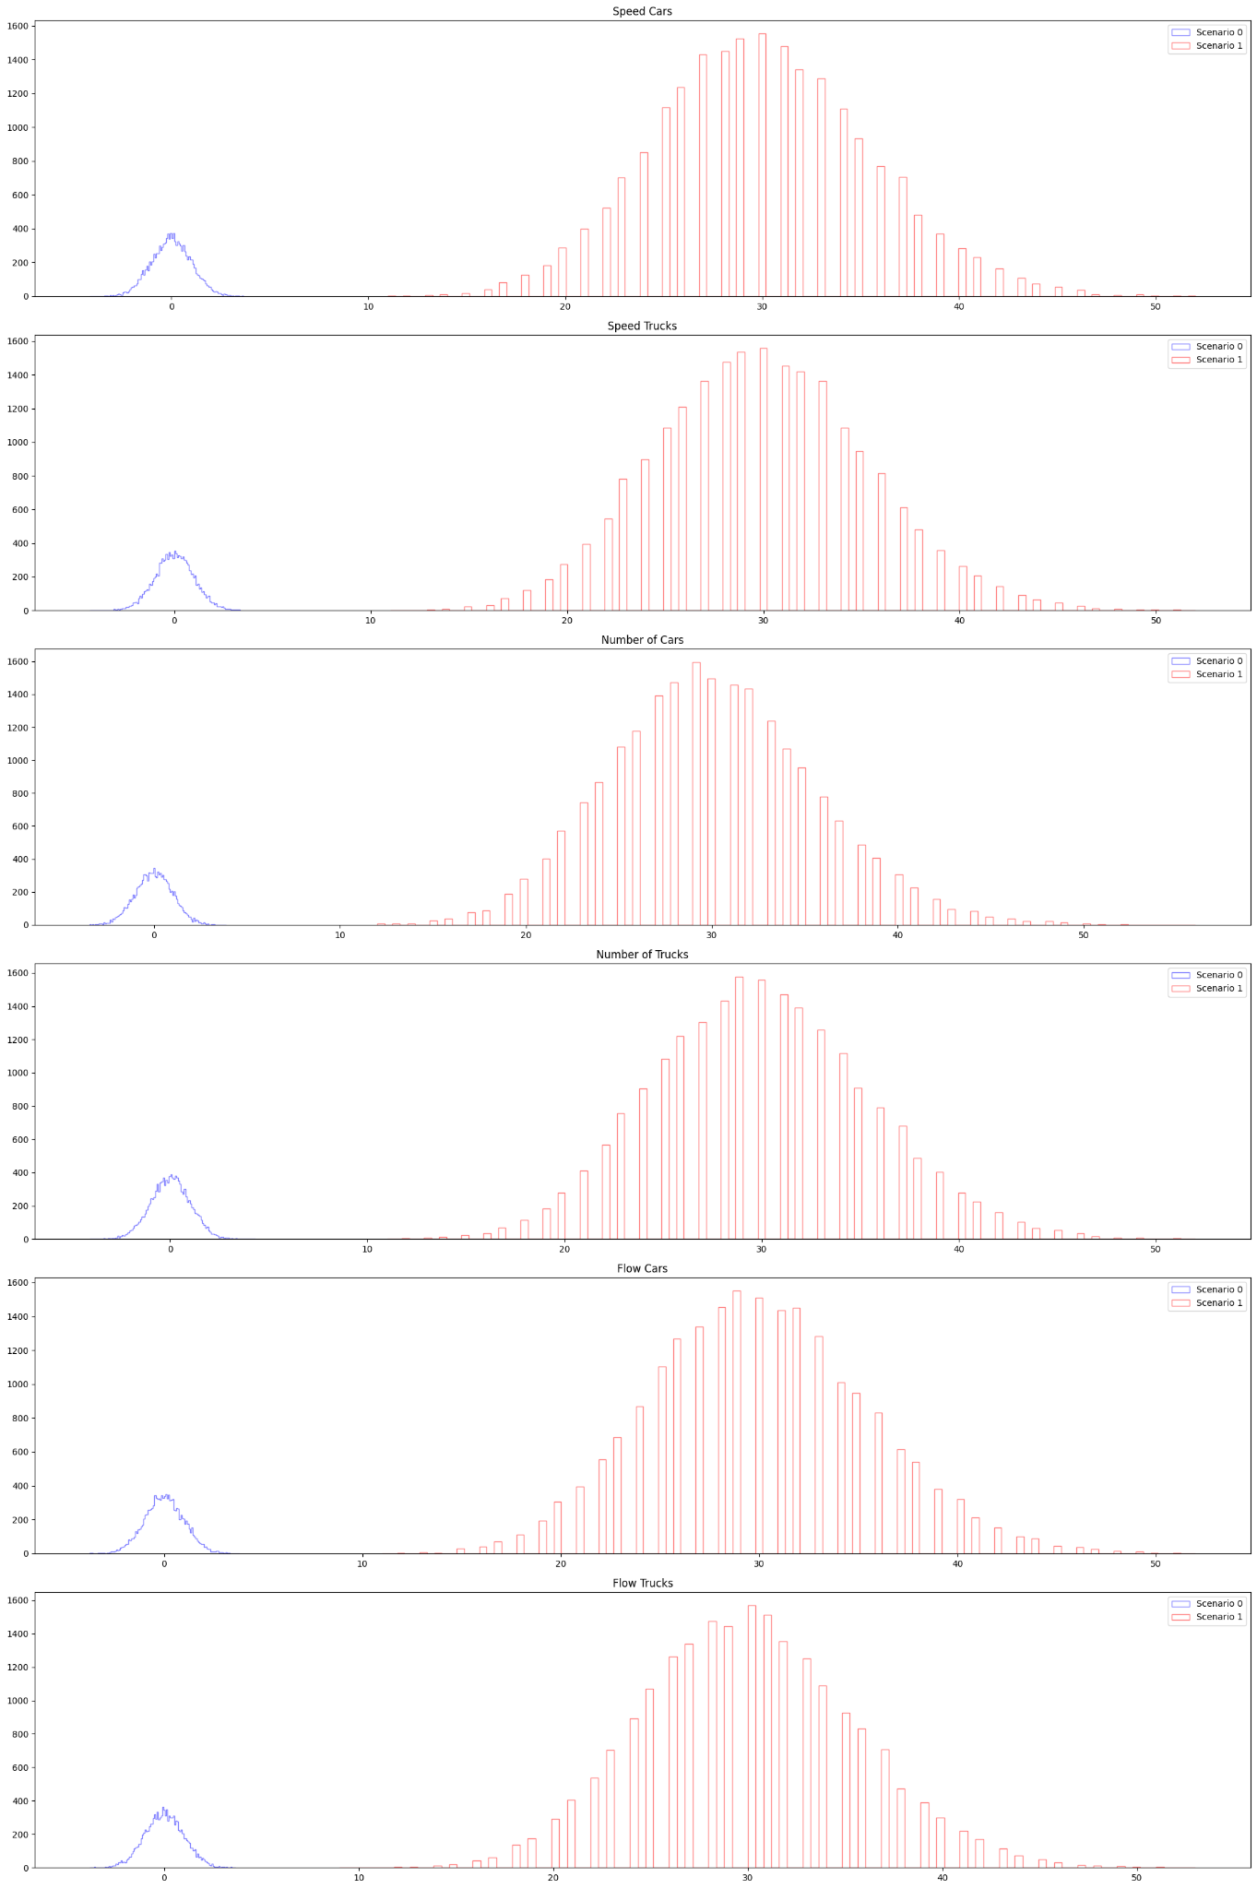
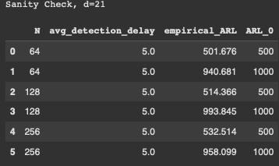
Sanity check (d=21), qtree ewma (K=32)

Slide 9
Small Change
Small policy change between scenarios.
Scenario 0: basic scenario (with some ferry traffic)
Scenario 1: basic scenario with a change obtained by moving slightly the phase of a traffic light
Gaussian noise (0 mean, 0.001 sigma) is added to the variables “flow cars” or “flow trucks” to deal with its discreteness.

Slide 10
Weekday Only

Slide 11
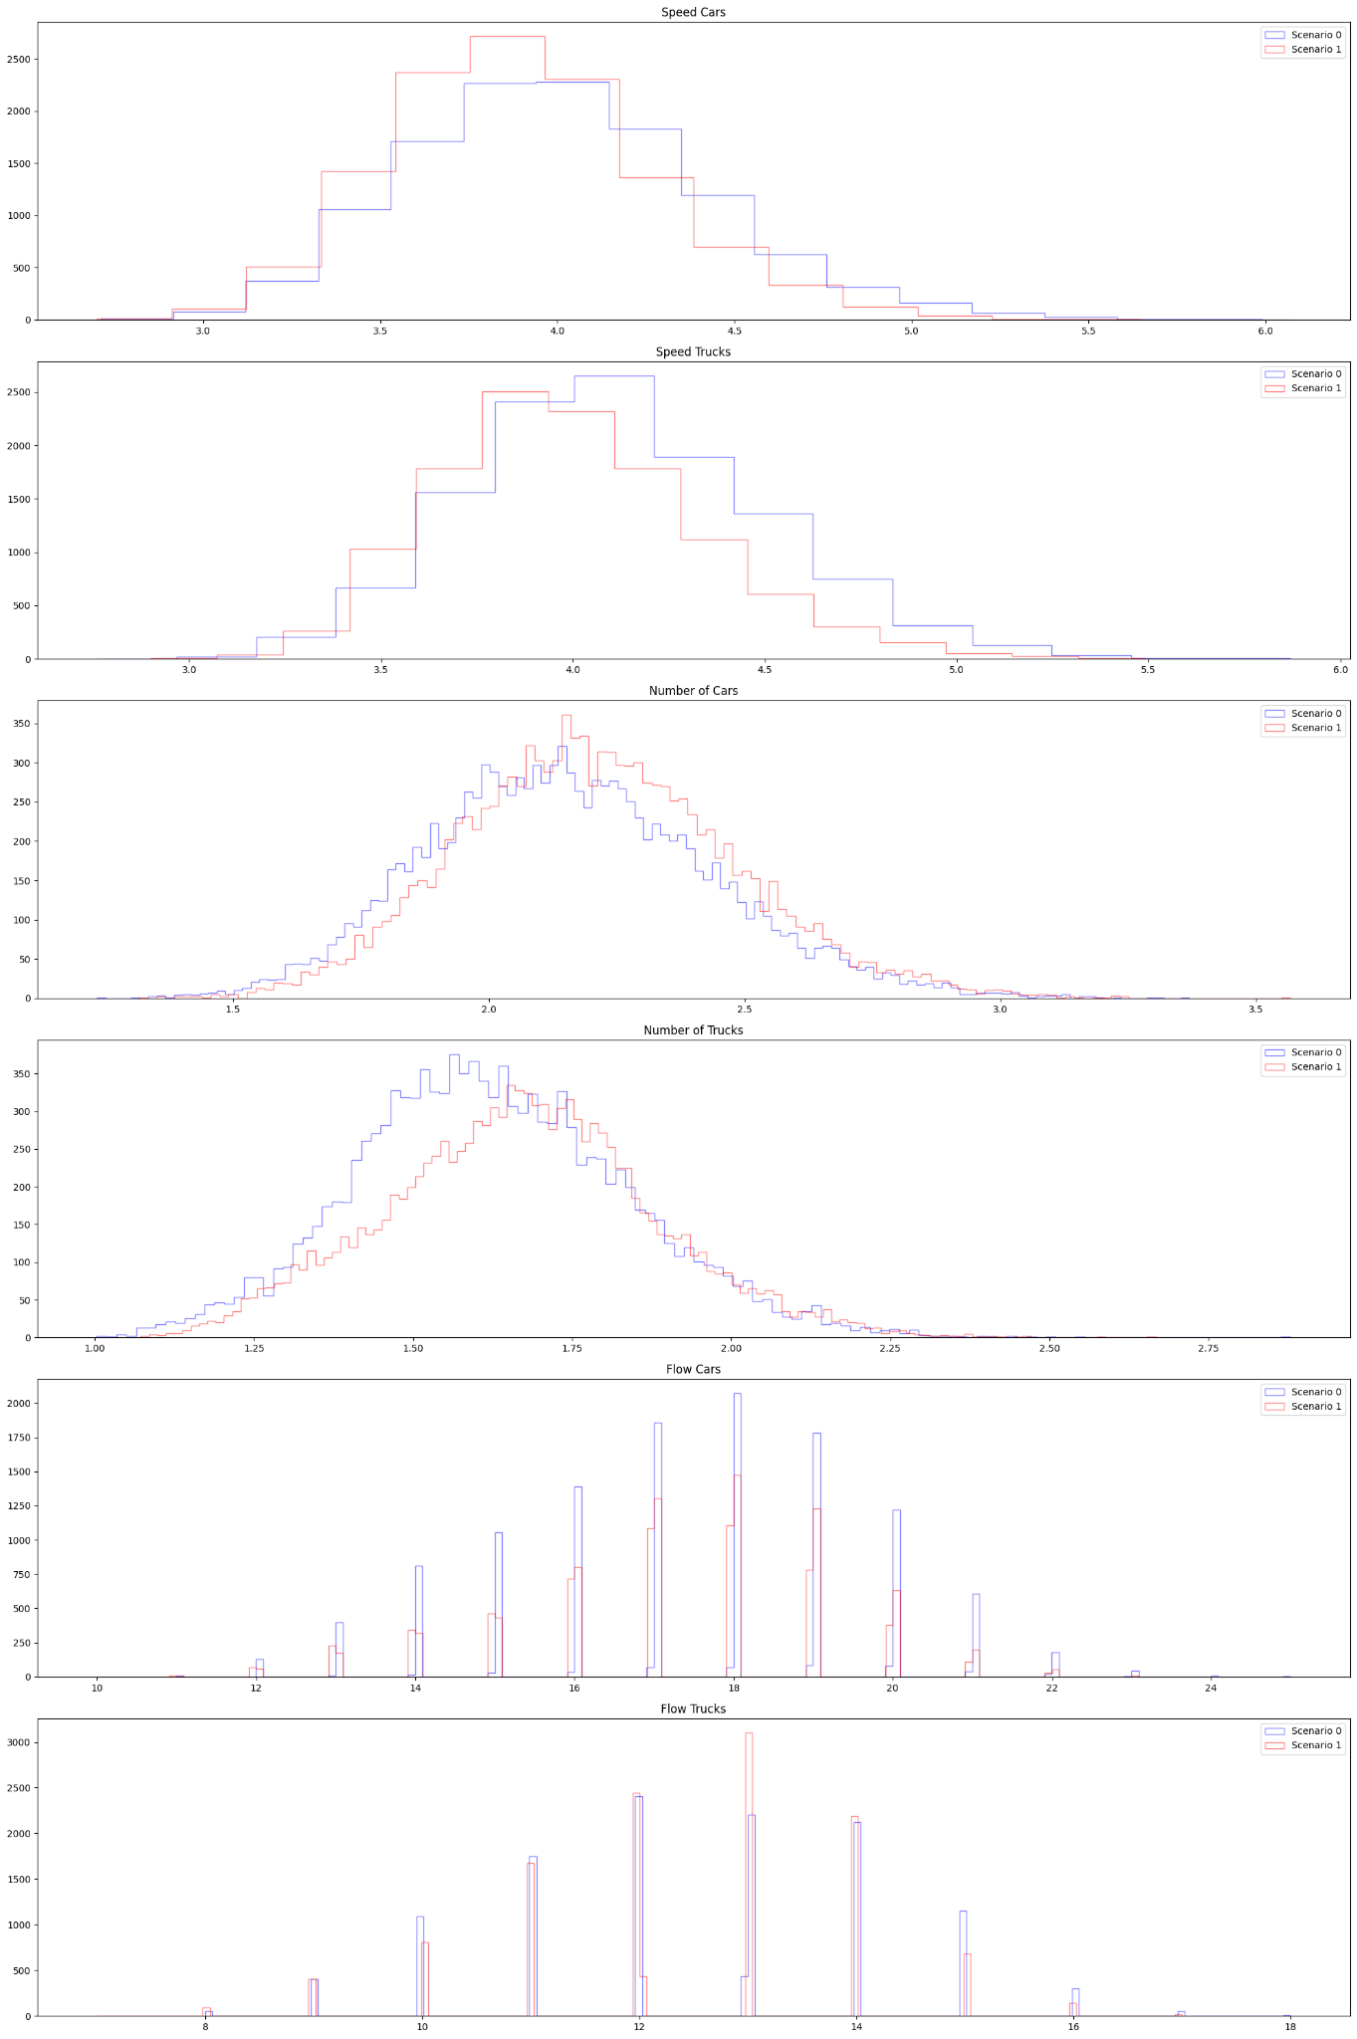
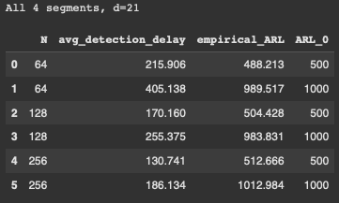
Small Change | All 4 segments (d=21), qtree ewma (K=32)
No change detected here?

Slide 12
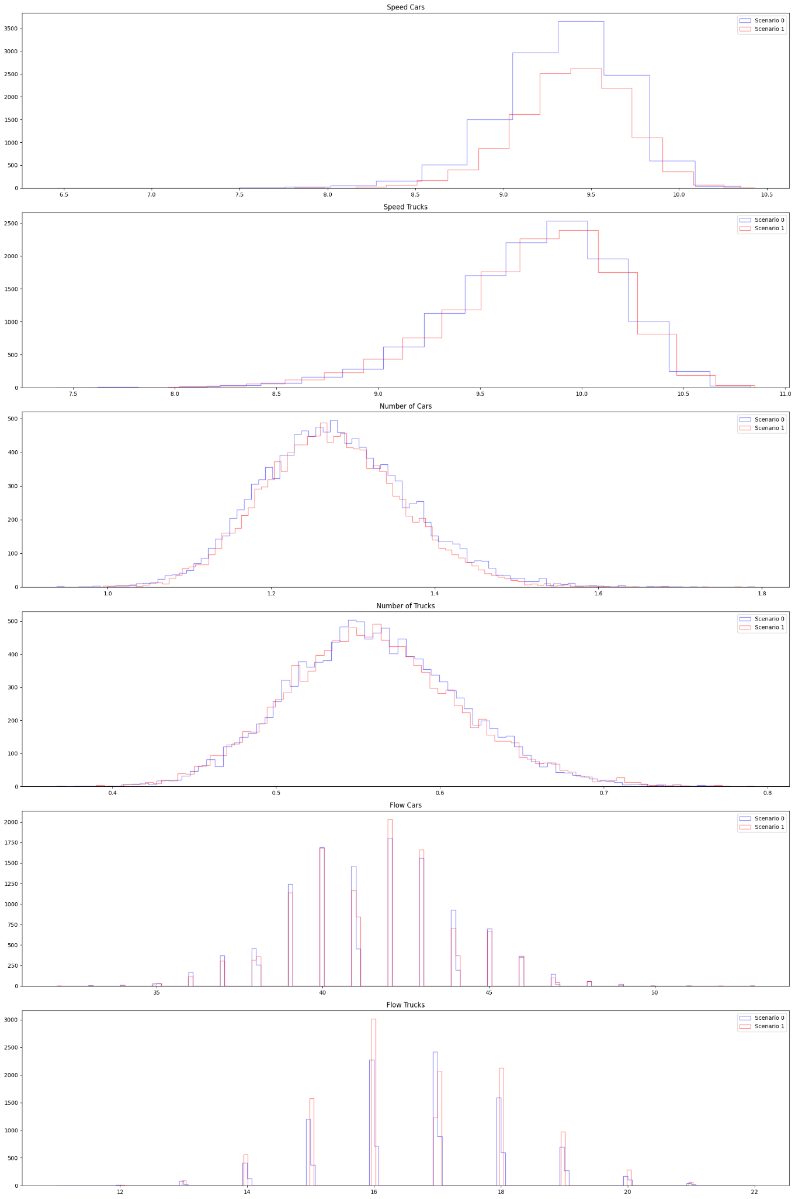
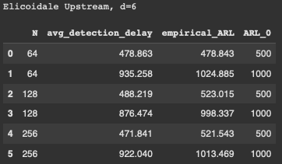
Small Change | Elicoidale Upstream (d=6), qtree ewma (K=32)
No change detected on this segment.

Slide 13
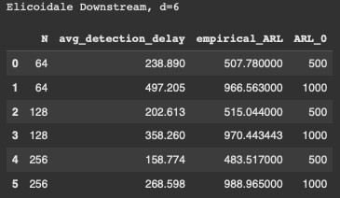
Small Change | Elicoidale Downstream (d=6), qtree ewma (K=32)
No change detected here?

Slide 14
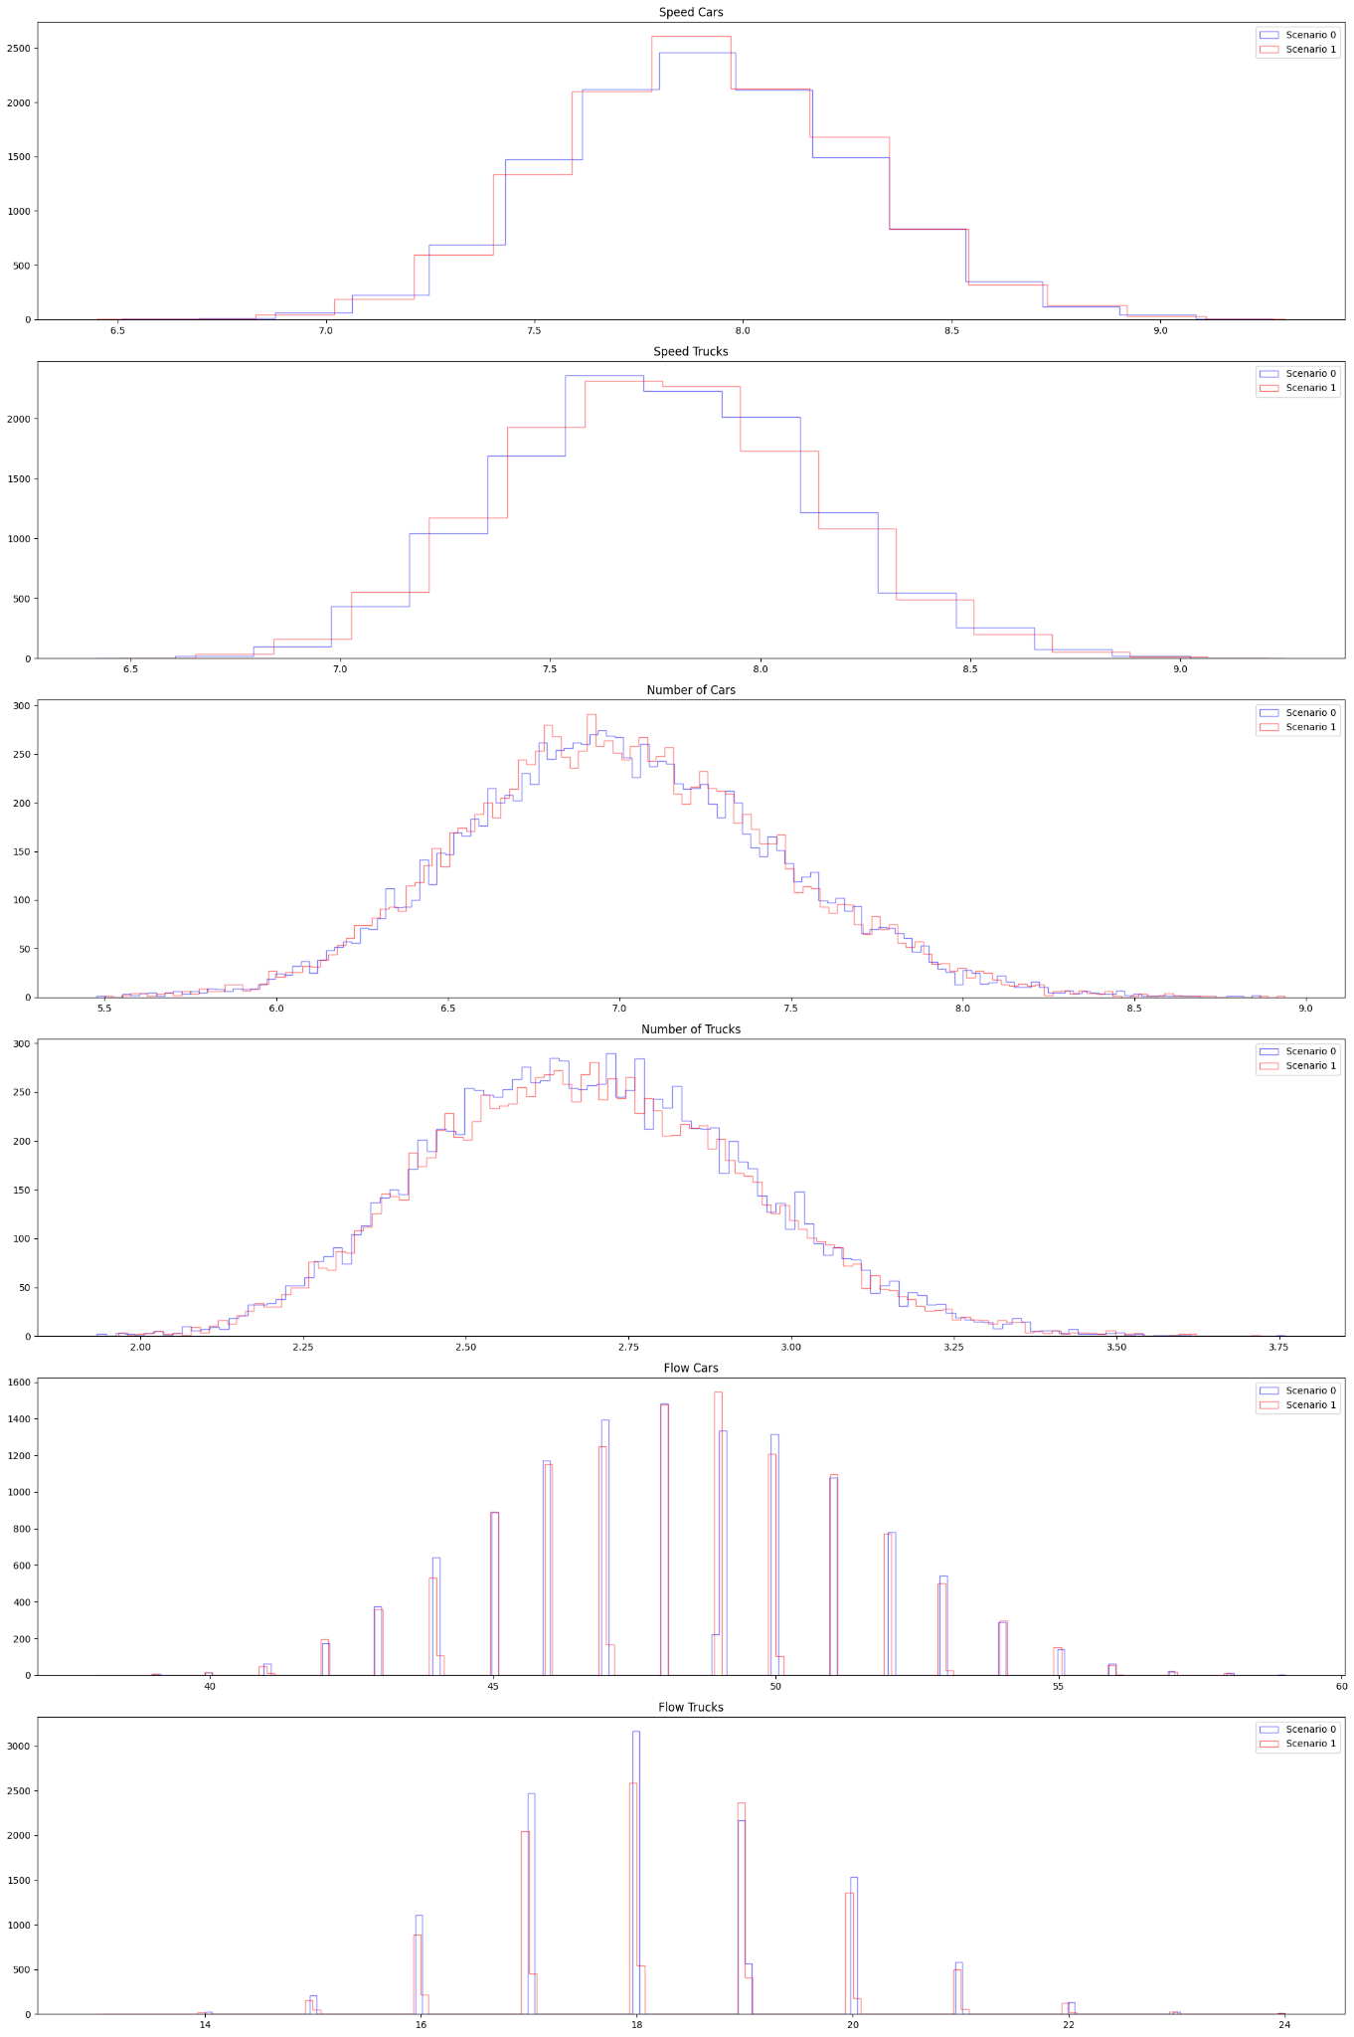
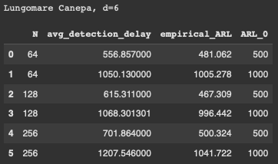
Small Change | Lungomare Canepa (d=6), qtree ewma (K=32)
No change detected on this segment.

Slide 15
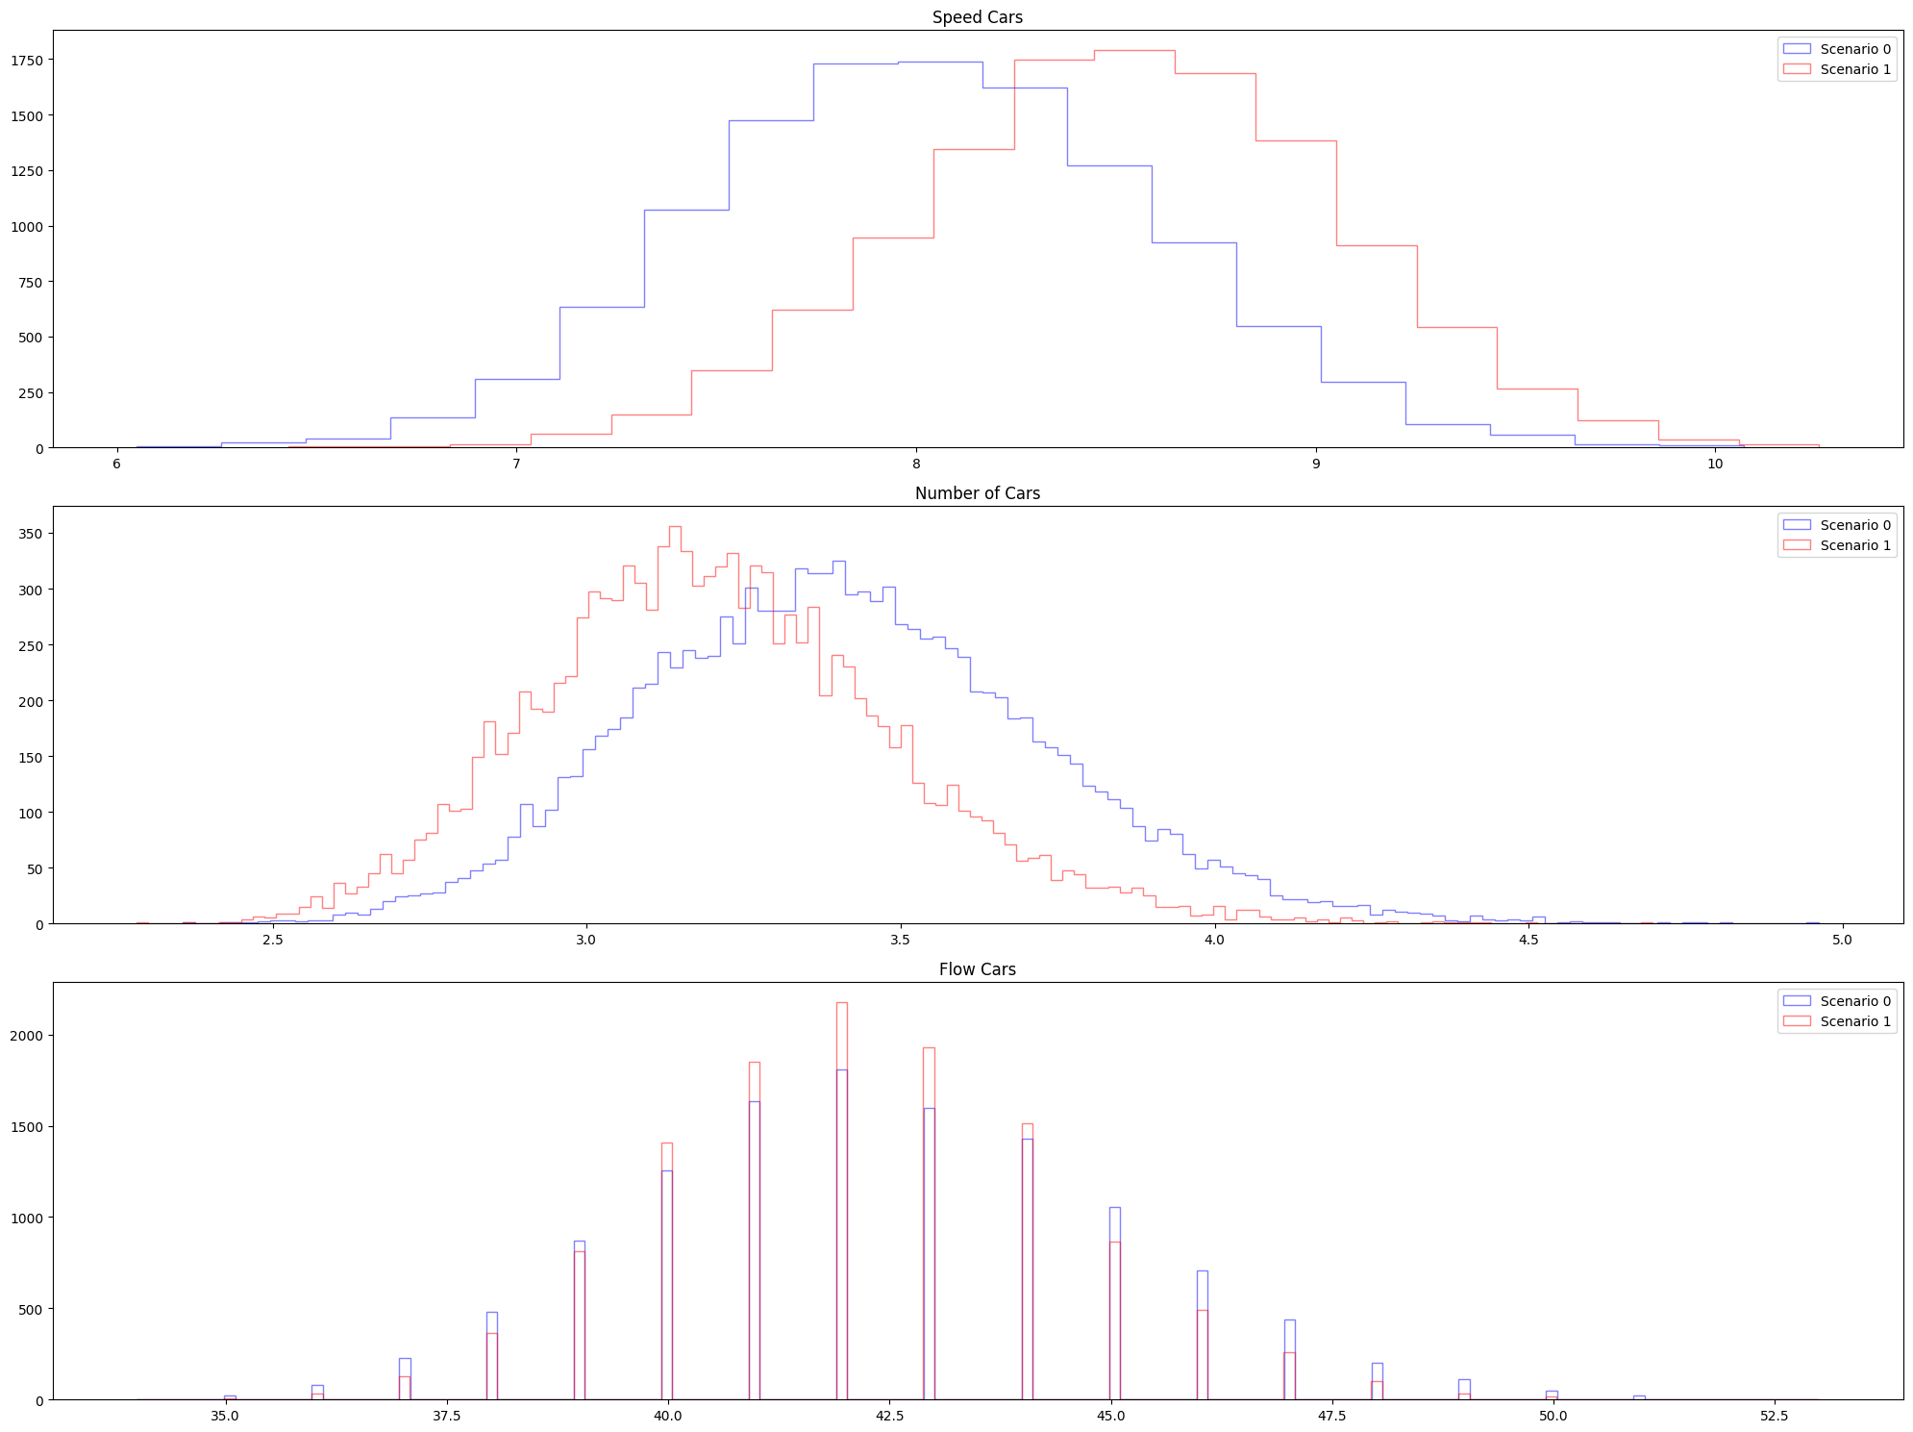
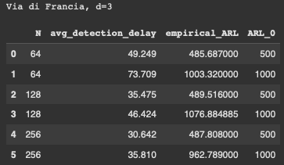
Small Change | Via di Francia (d=3), qtree ewma (K=32)
Even if the change was minimal, it might have affected this segment. Here it is being detected in around 1 to 2 months.

Slide 16
Weekend Only

Slide 17
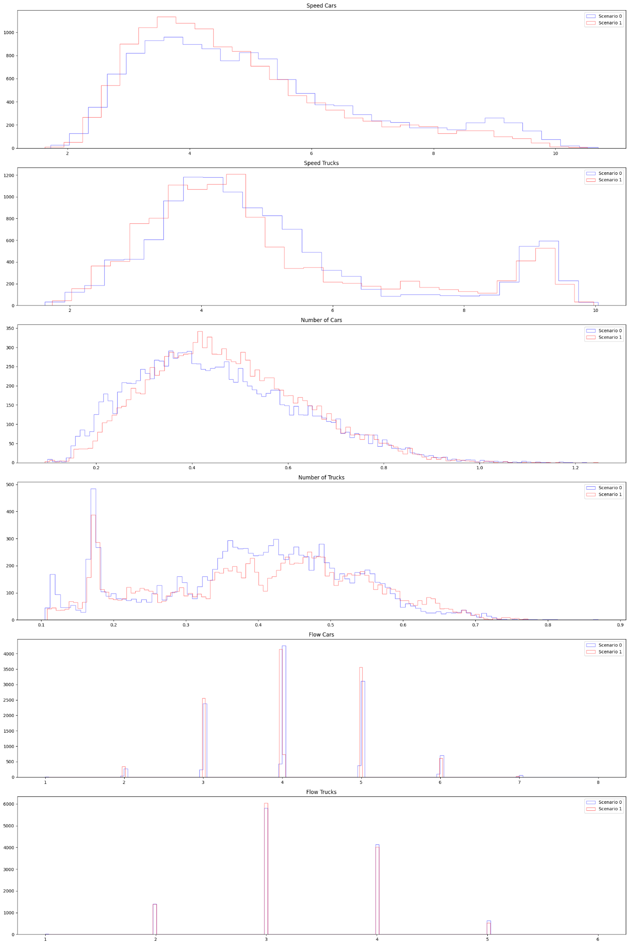
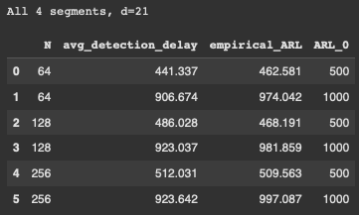
Small Change | All 4 segments (d=21), qtree ewma (K=32)
No change detected.

Slide 18
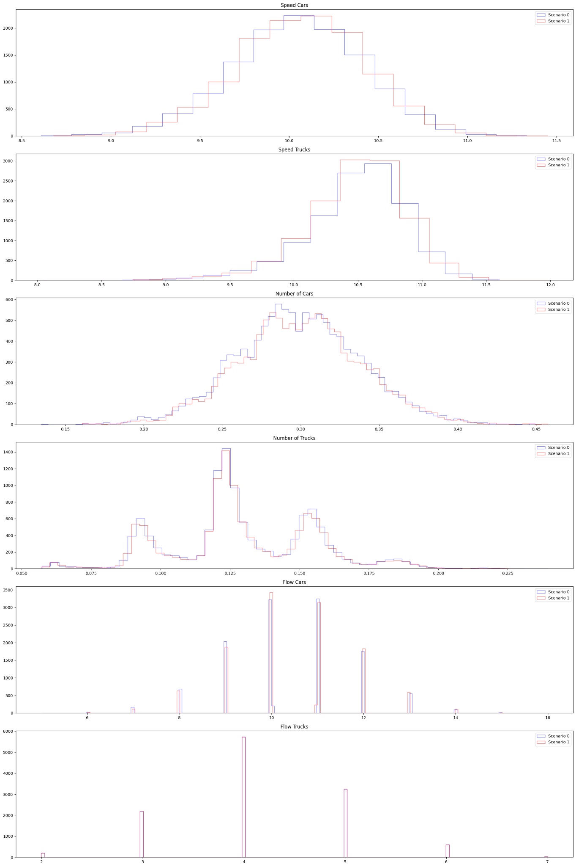
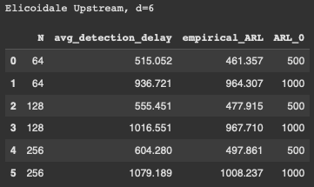
Small Change | Elicoidale Upstream (d=6), qtree ewma (K=32)
No change detected.

Slide 19
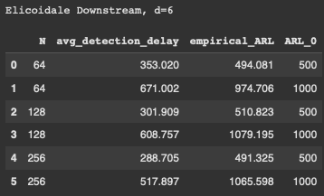
Small Change | Elicoidale Downstream (d=6), qtree ewma (K=32)
No change detected here?

Slide 20
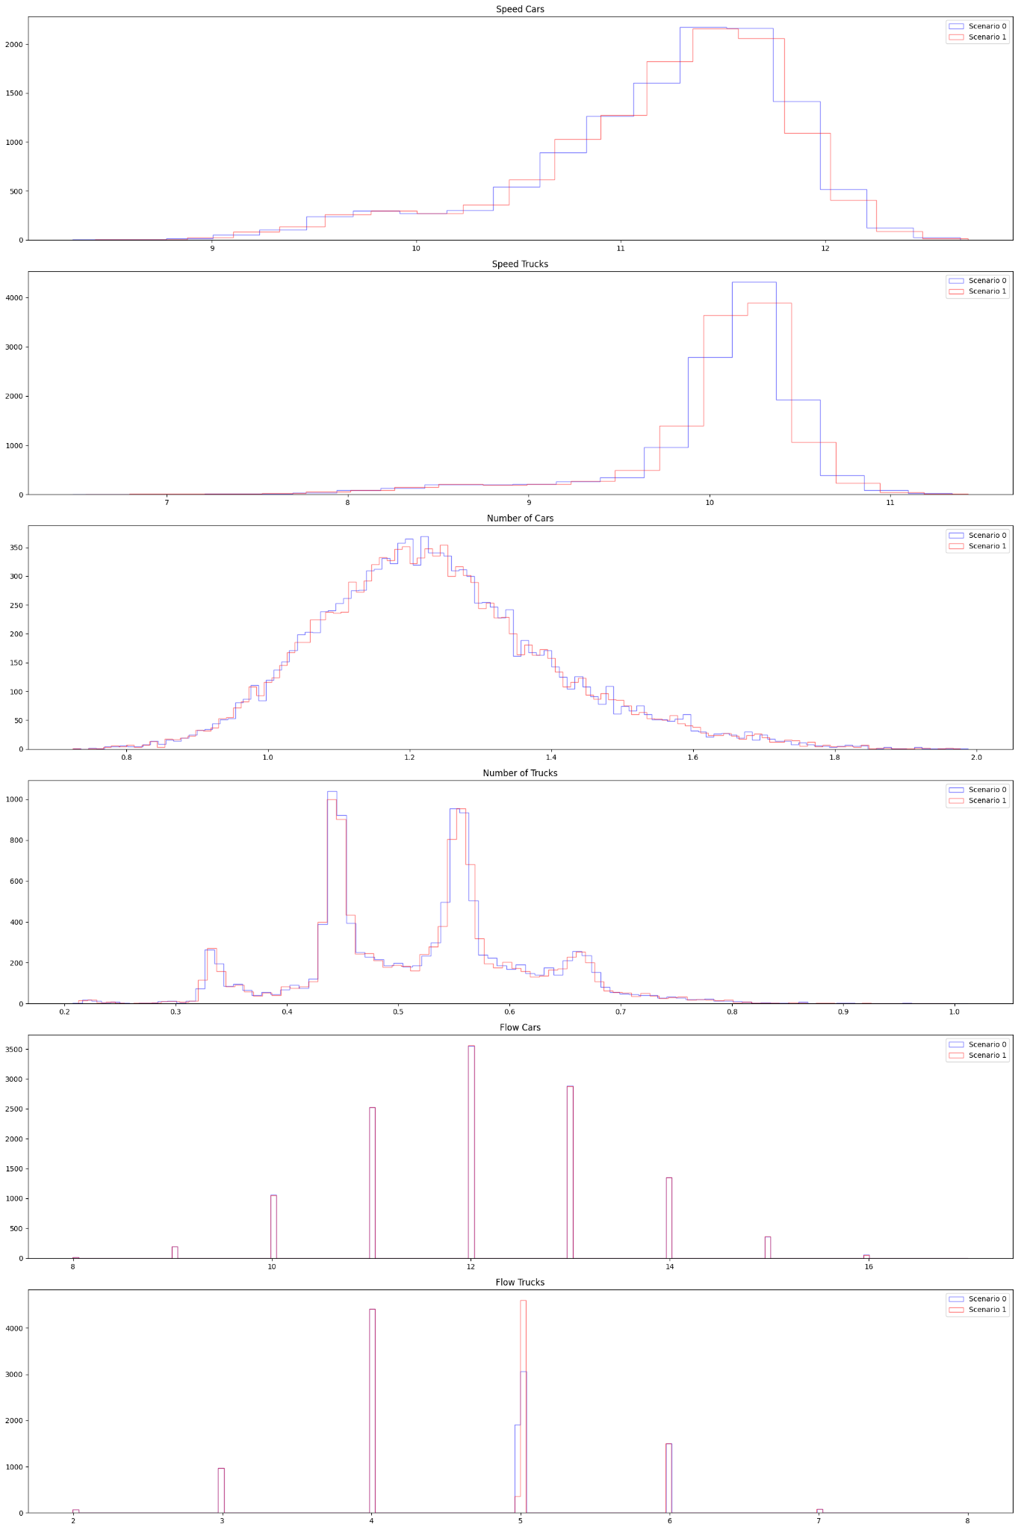
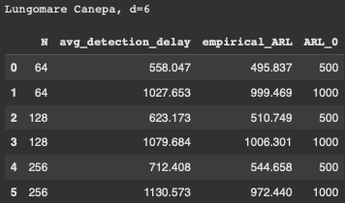
Small Change | Lungomare Canepa (d=6), qtree ewma (K=32)
No change detected.

Slide 21
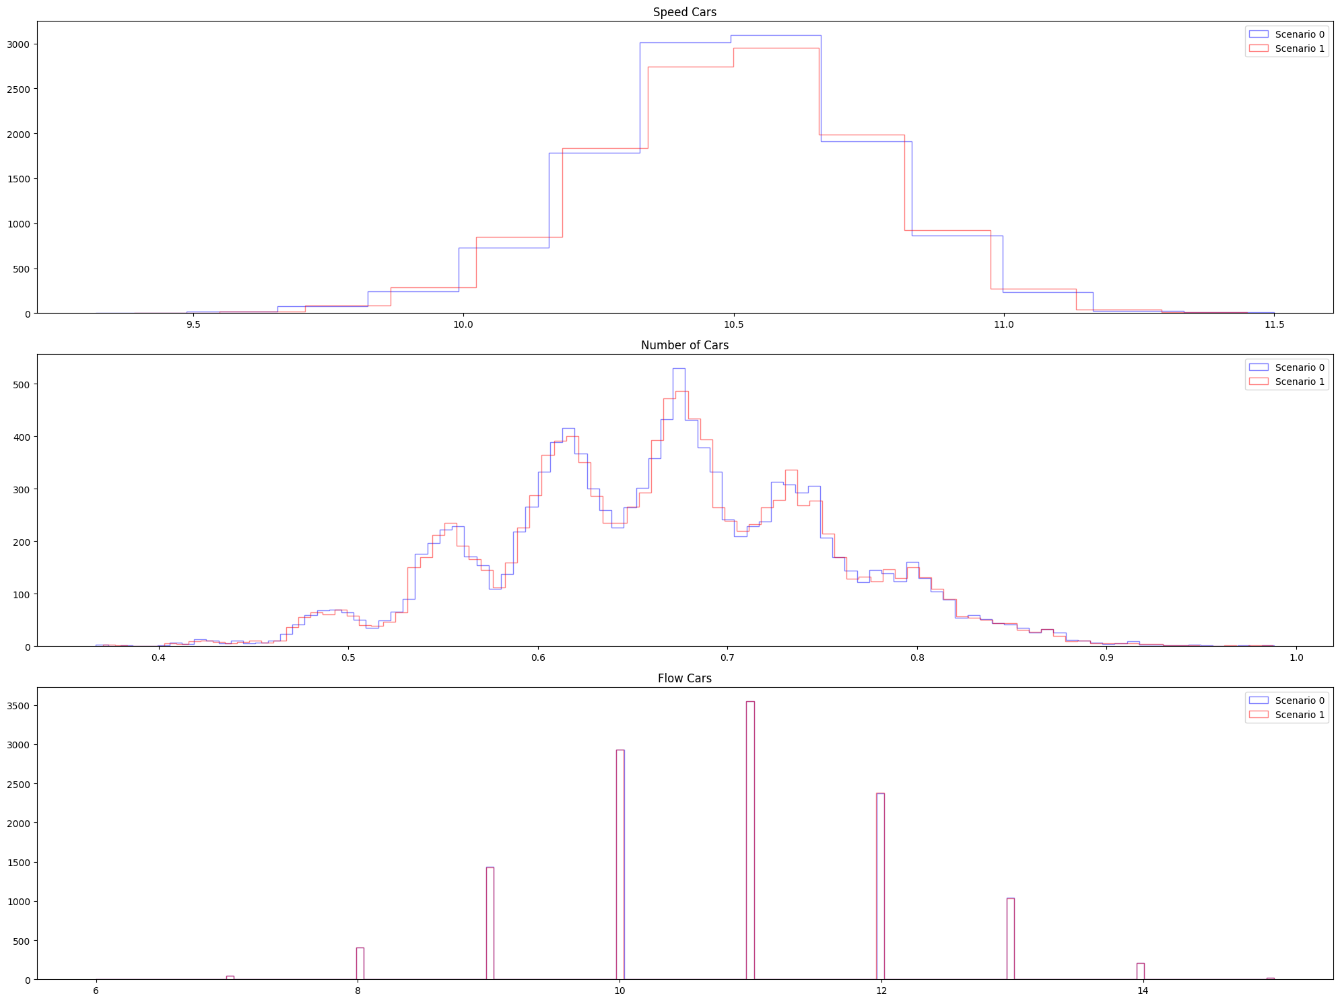
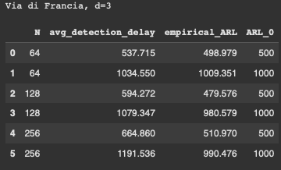
Small Change | Via di Francia (d=3), qtree ewma (K=32)
No change detected.

Slide 22
Mixture
Weekday (70%) + Weekend (30%)

Slide 23
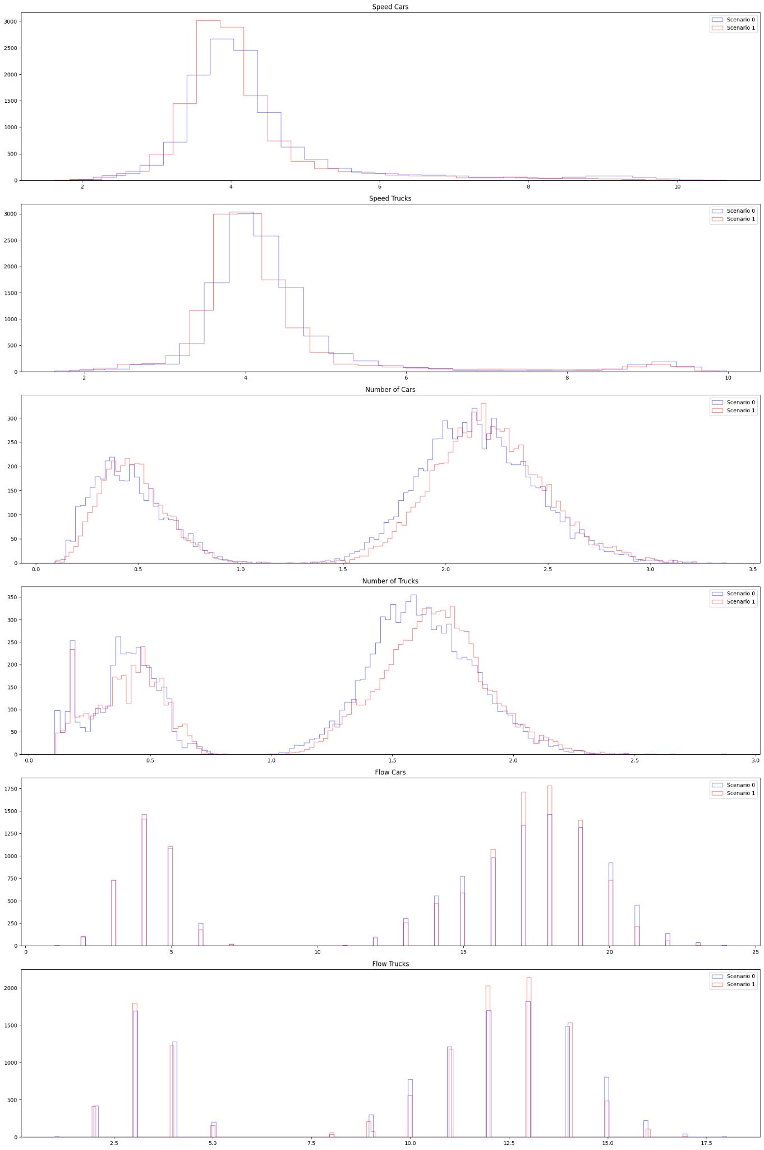
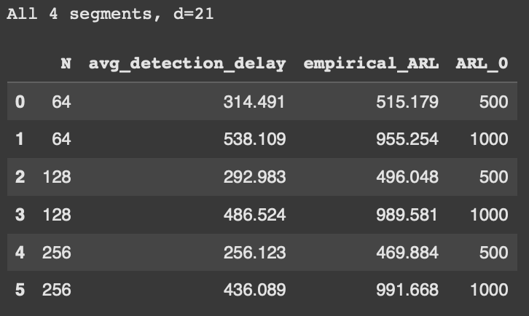
Small Change | All 4 segments (d=21), qtree ewma (K=32)
No change detected here?

Slide 24
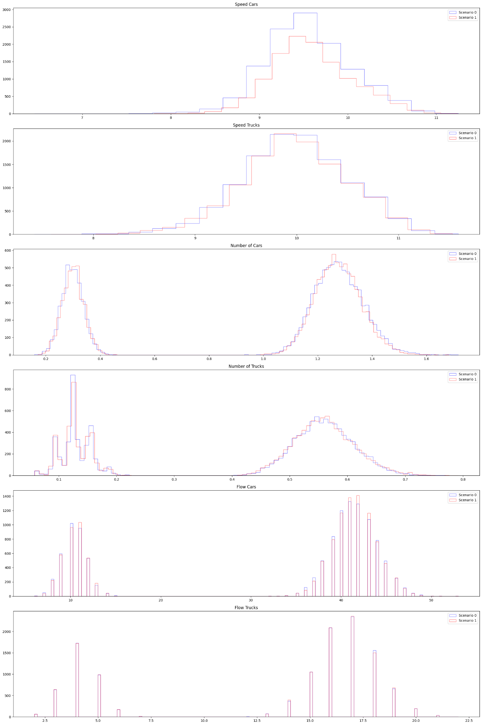
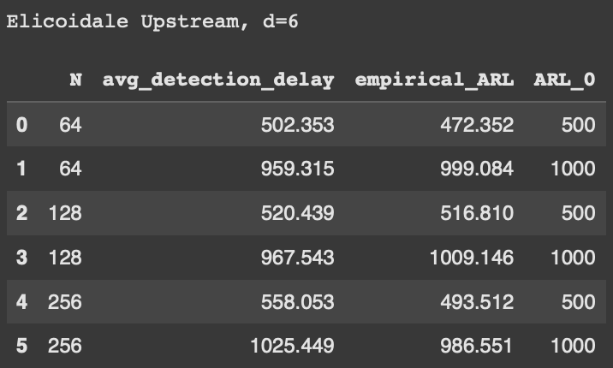
Small Change | Elicoidale Upstream (d=6), qtree ewma (K=32)
No change detected on this segment.

Slide 25
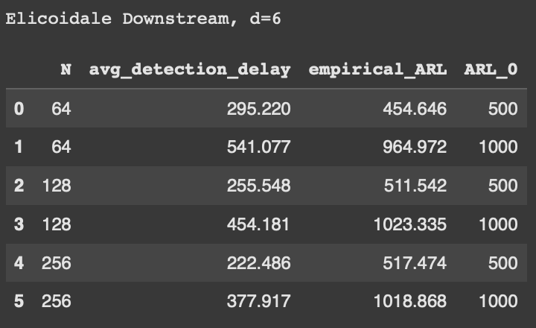
Small Change | Elicoidale Downstream (d=6), qtree ewma (K=32)

Slide 26
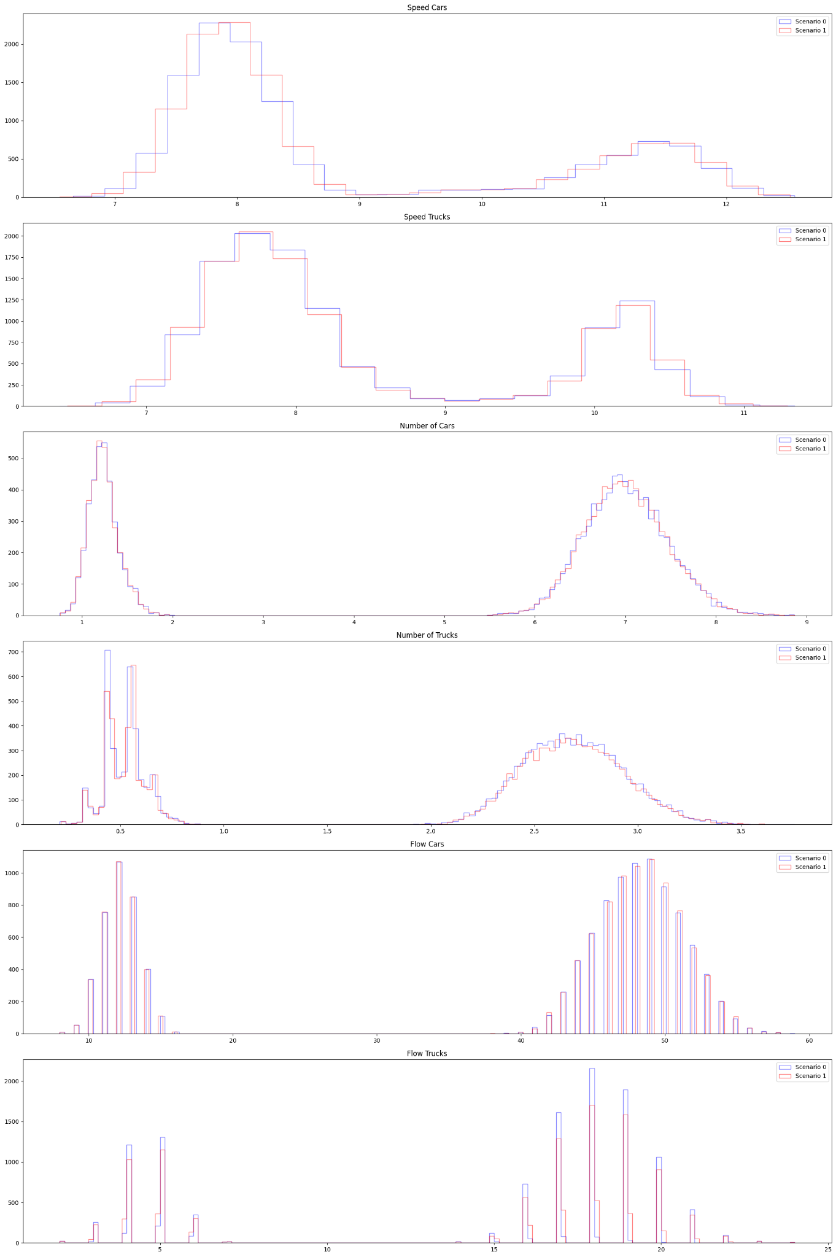
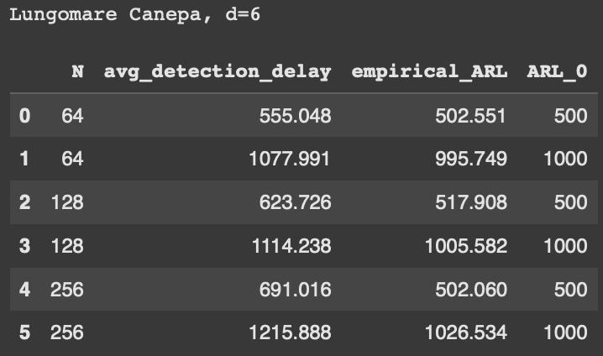
Small Change | Lungomare Canepa (d=6), qtree ewma (K=32)
No change detected on this segment.

Slide 27
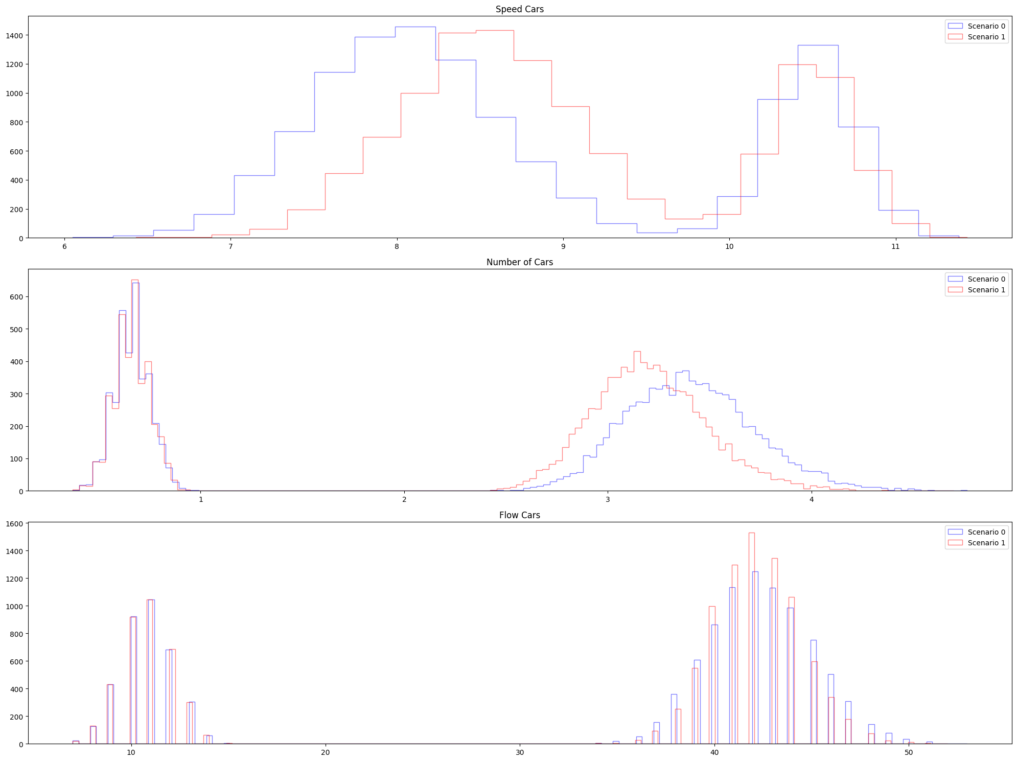
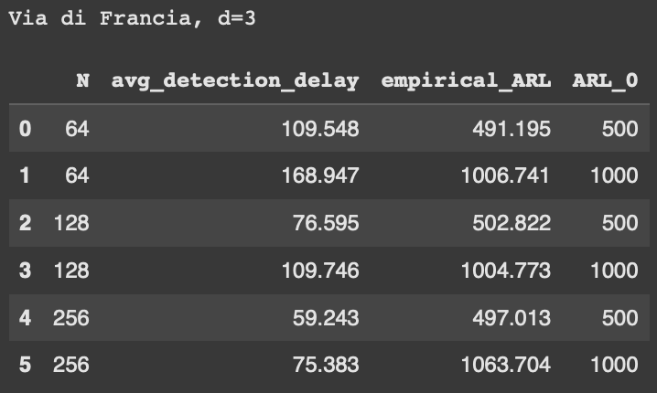
Small Change | Via di Francia (d=3), qtree ewma (K=32)
Again, here even if the change is minimal, it might have affected this segment, it is detected in around 3 months.

Slide 28
Medium Change
Medium policy change between scenarios.
Scenario 0: basic scenario (with some ferry traffic)
Scenario 1: basic scenario with a change obtained by moving slightly the phase of a traffic light, with a little change also in the phase of another traffic light.
Gaussian noise (0 mean, 0.001 sigma) is added to the variables “flow cars” or “flow trucks” to deal with its discreteness.

Slide 29
Weekday Only

Slide 30
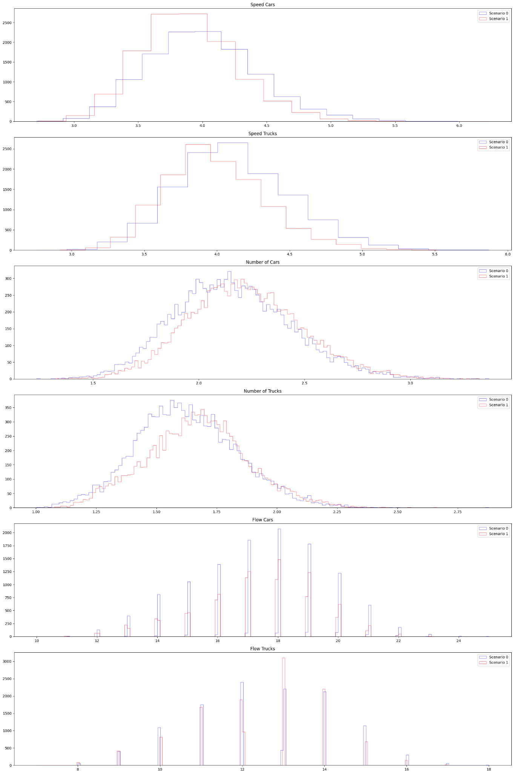
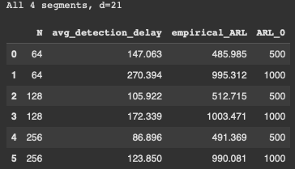
Medium Change | All 4 segments (d=21), qtree ewma (K=32)
Change detected around 5 months later. Do we consider it a detection?

Slide 31
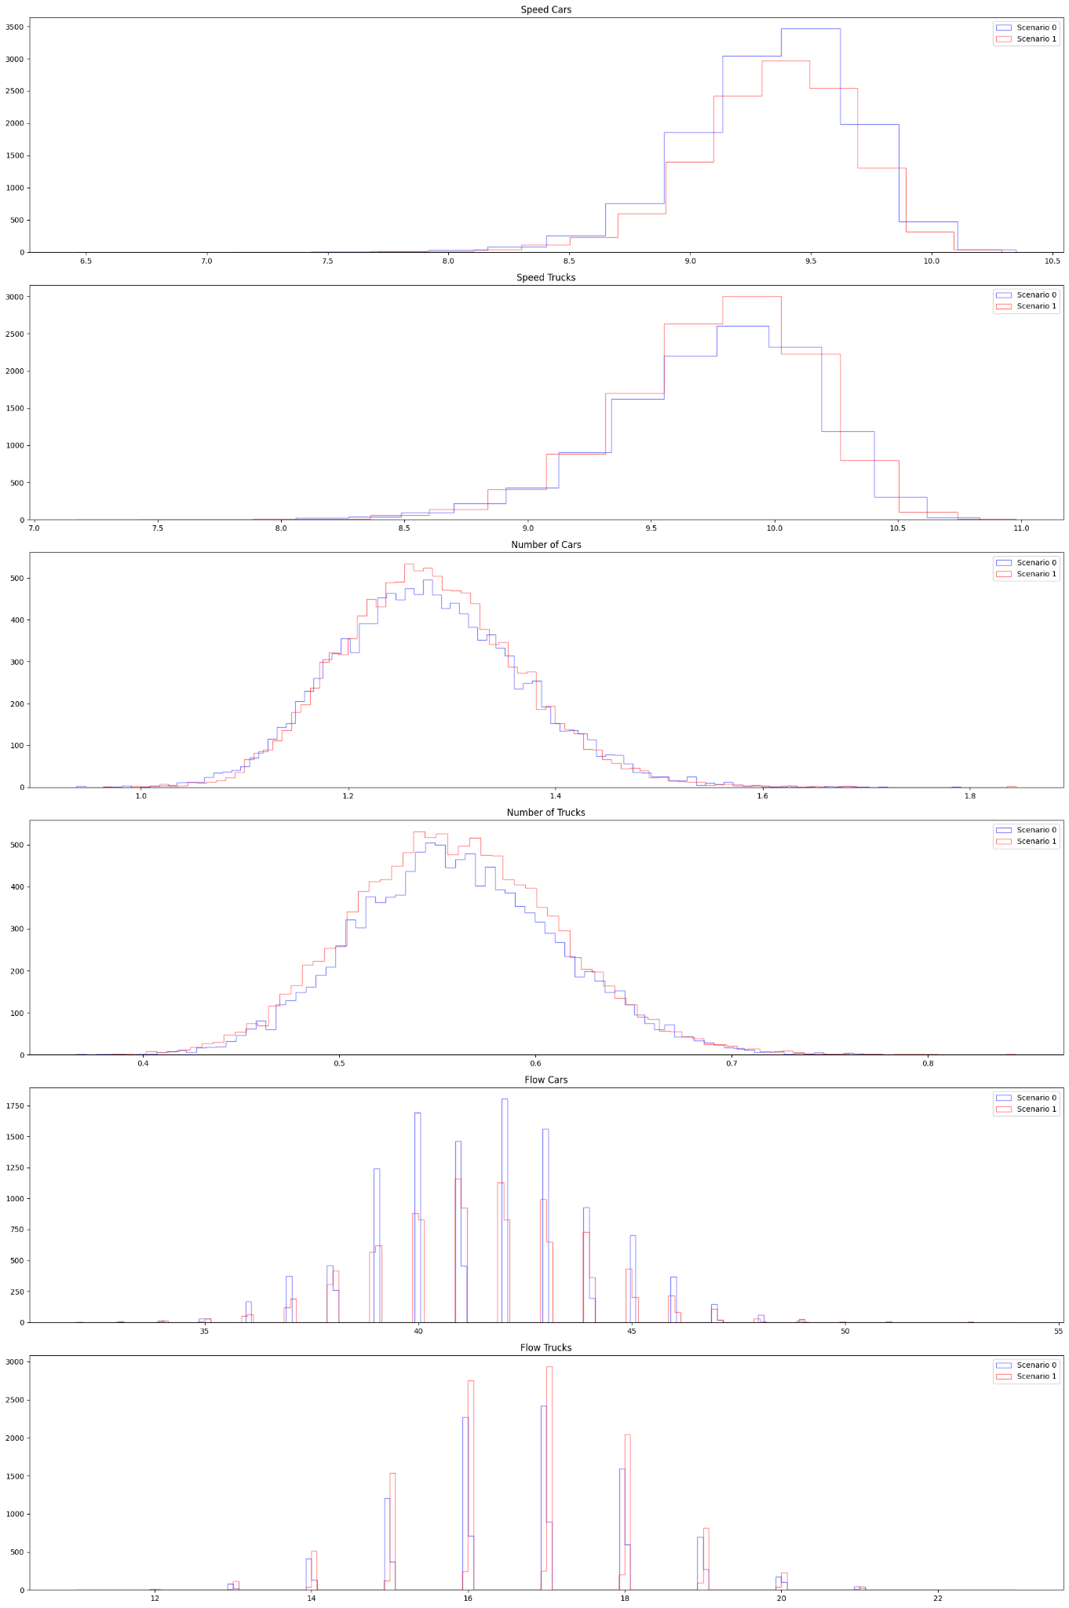
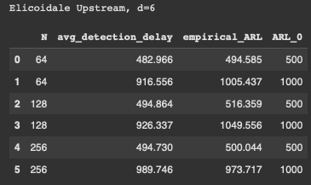
Medium Change | Elicoidale Upstream (d=6), qtree ewma (K=32)
No change detected here.

Slide 32
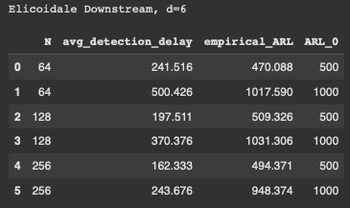
Medium Change | Elicoidale Downstream (d=6), qtree ewma (K=32)
No change detected here?

Slide 33
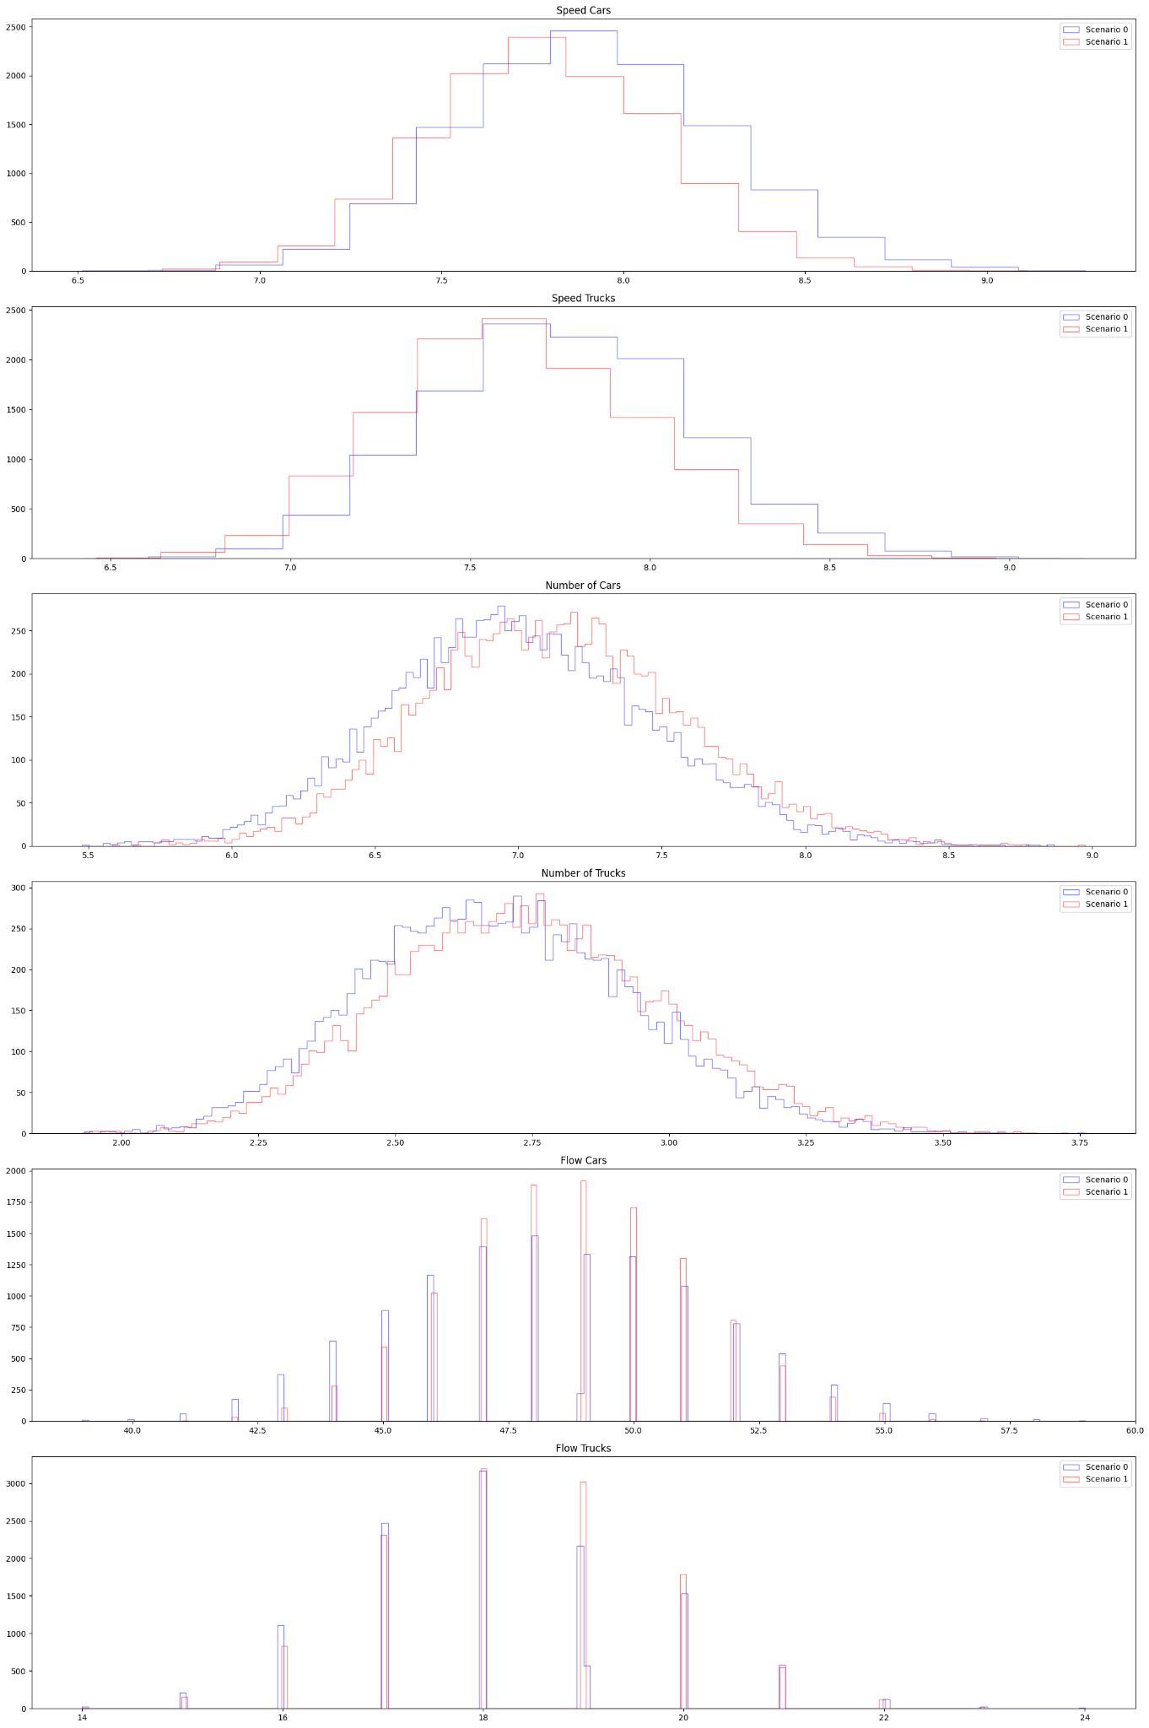
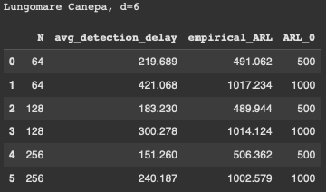
Medium Change | Lungomare Canepa (d=6), qtree ewma (K=32)
No change detected here?

Slide 34
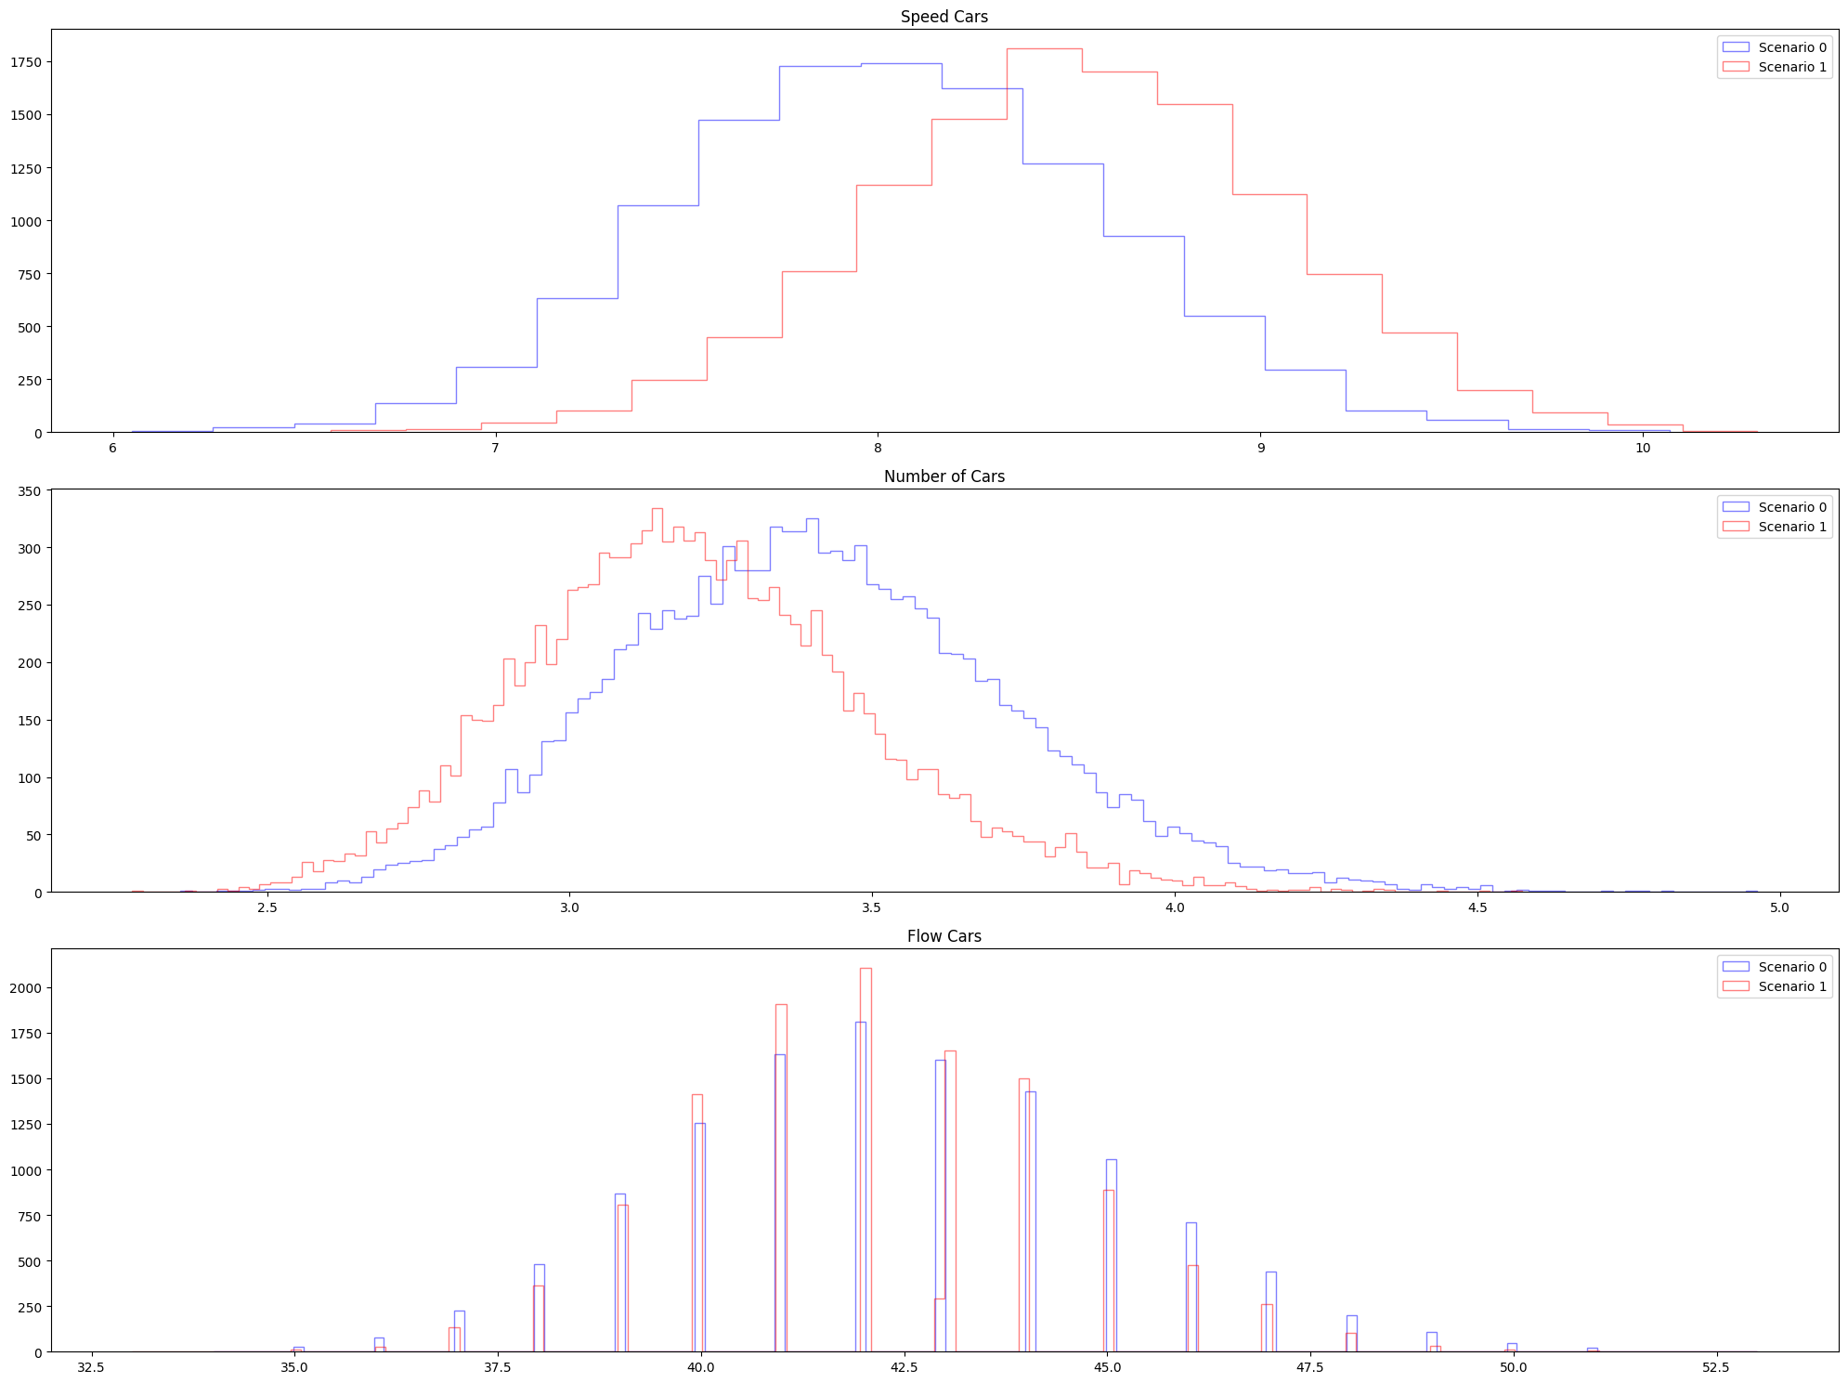
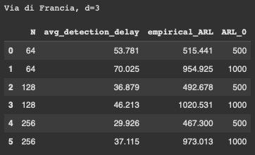
Medium Change | Via di Francia (d=3), qtree ewma (K=32)
Change detected around 2 months later.

Slide 35
Weekend Only

Slide 36
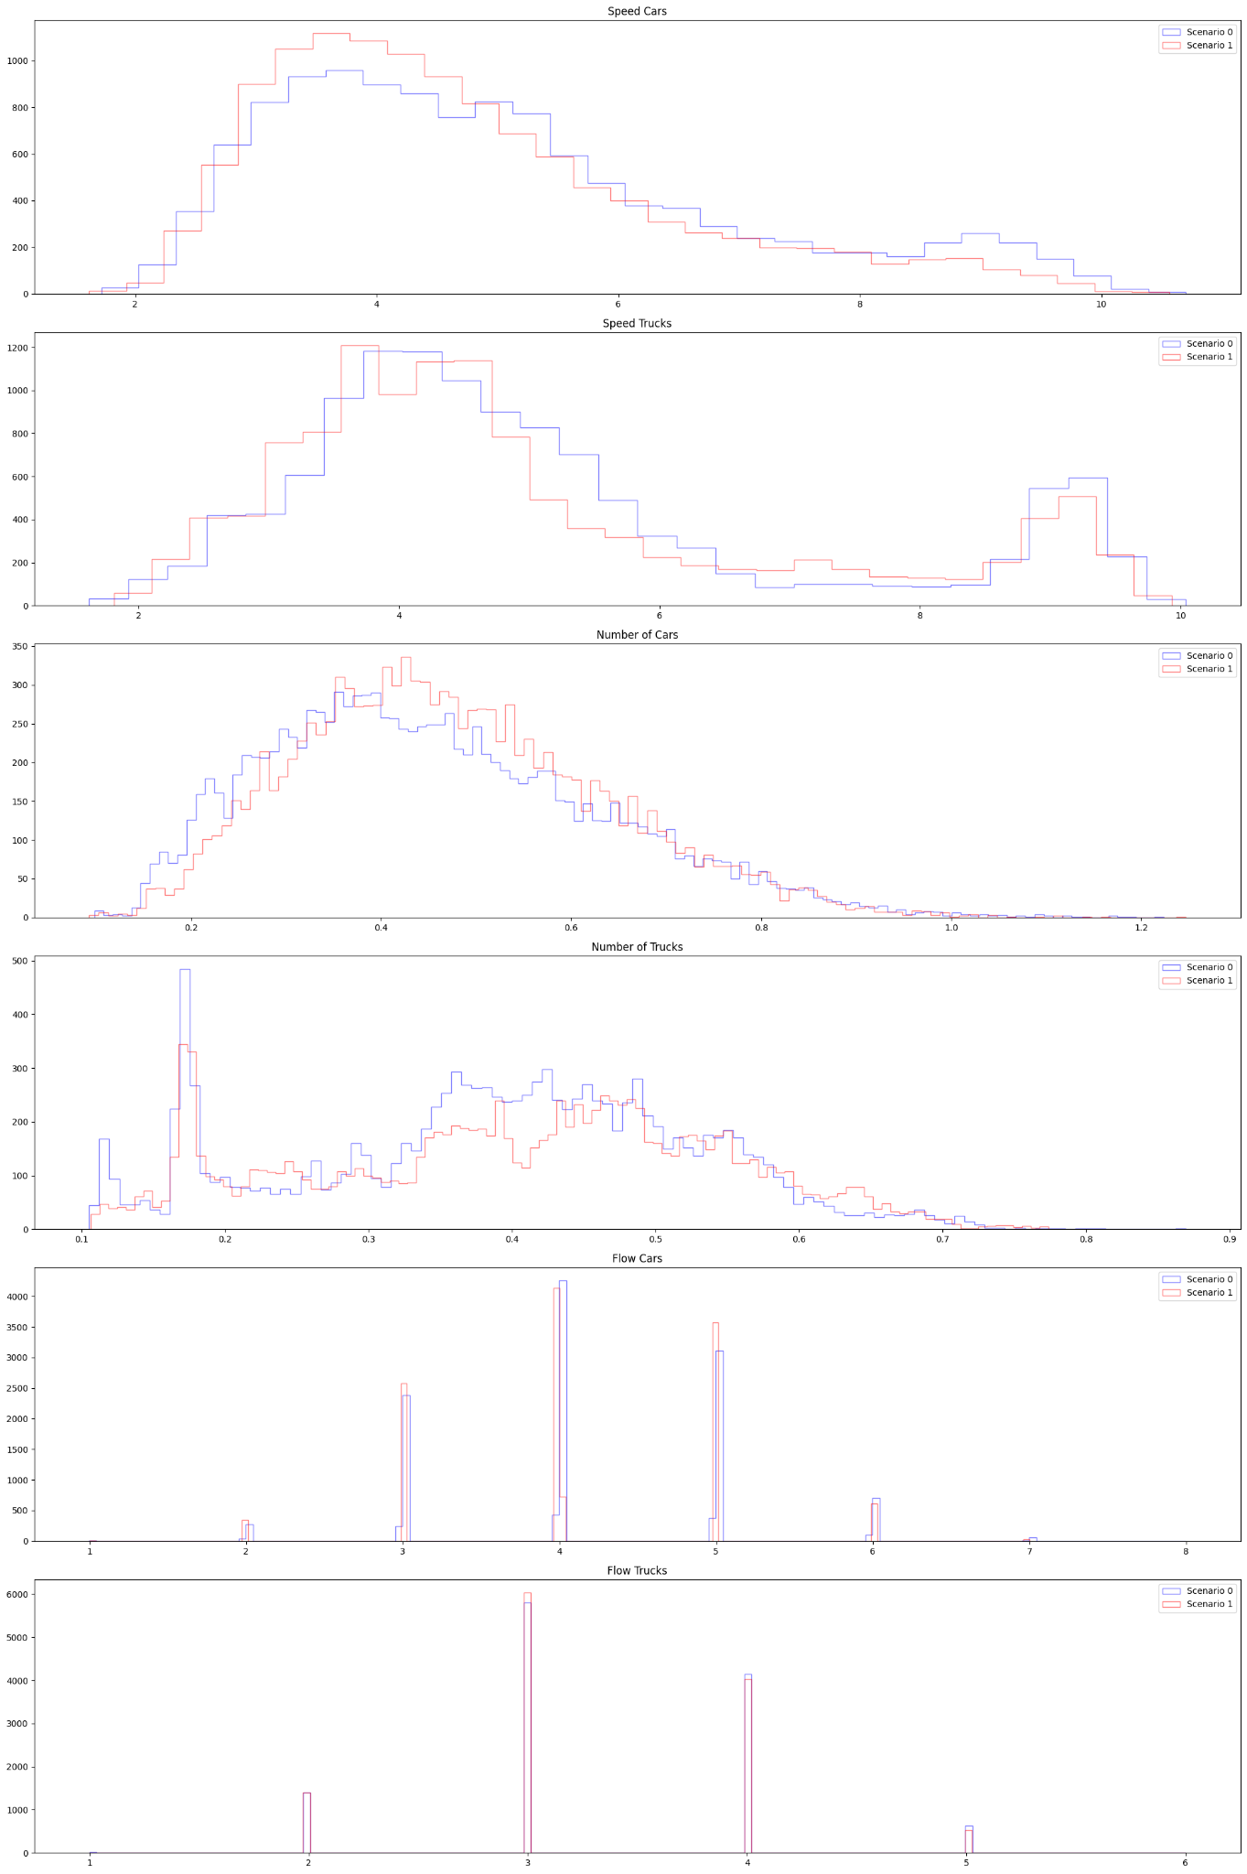
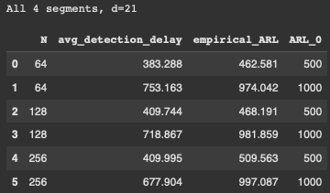
Medium Change | All 4 segments (d=21), qtree ewma (K=32)
No change detected.

Slide 37
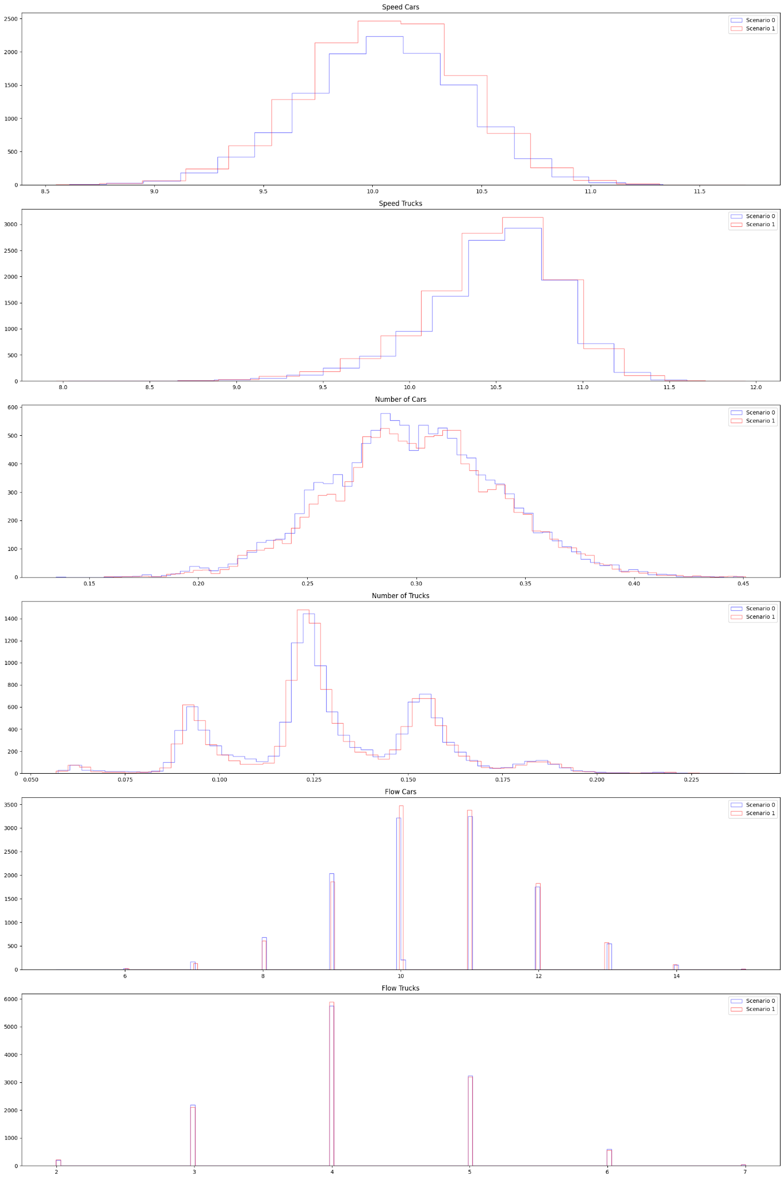
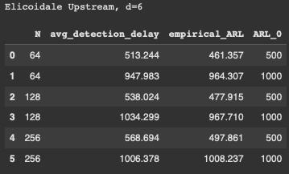
Medium Change | Elicoidale Upstream (d=6), qtree ewma (K=32)
No change detected.

Slide 38
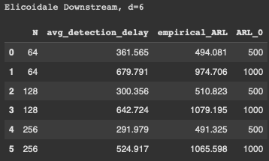
Medium Change | Elicoidale Downstream (d=6), qtree ewma (K=32)
No change detected here.

Slide 39
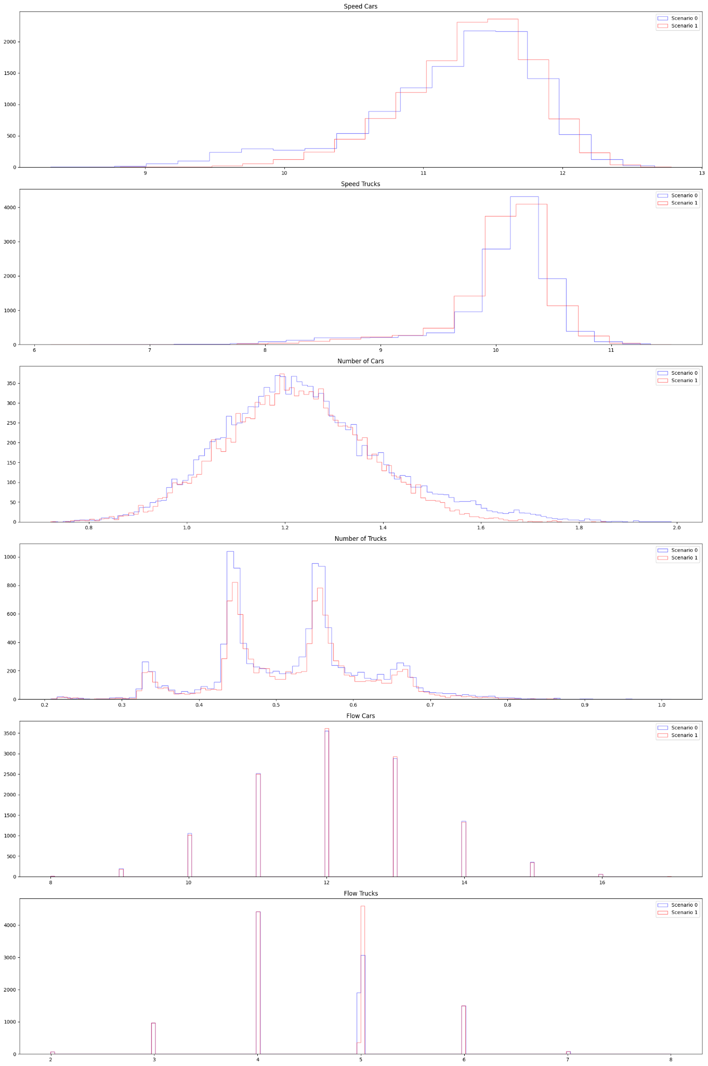
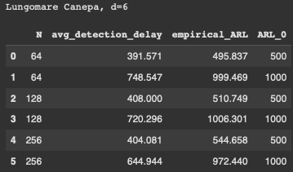
Medium Change | Lungomare Canepa (d=6), qtree ewma (K=32)
No change detected.

Slide 40
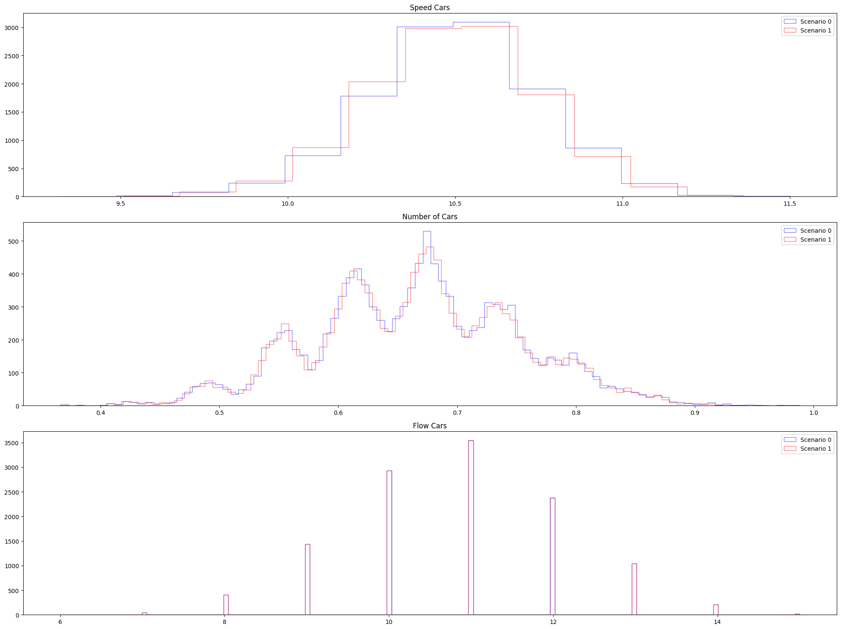
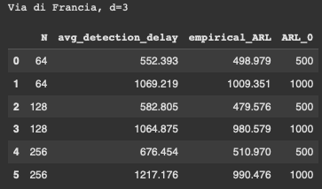
Medium Change | Via di Francia (d=3), qtree ewma (K=32)
No change detected.

Slide 41
Mixture
Weekday (70%) + Weekend (30%)

Slide 42
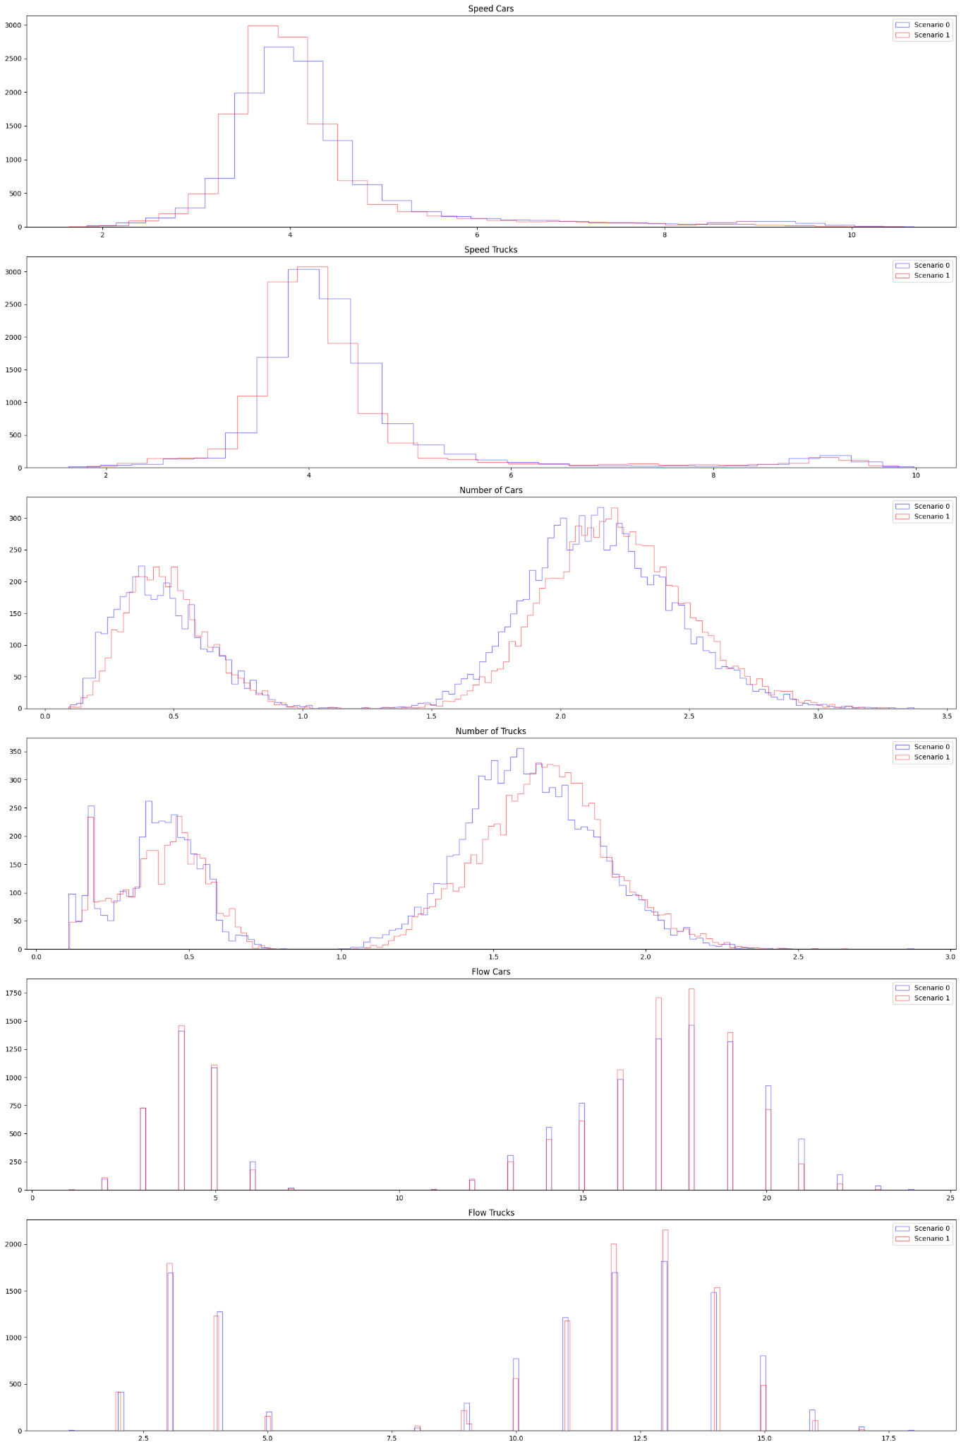

Medium Change | All 4 segments (d=21), qtree ewma (K=32)
No change detected here.

Slide 43
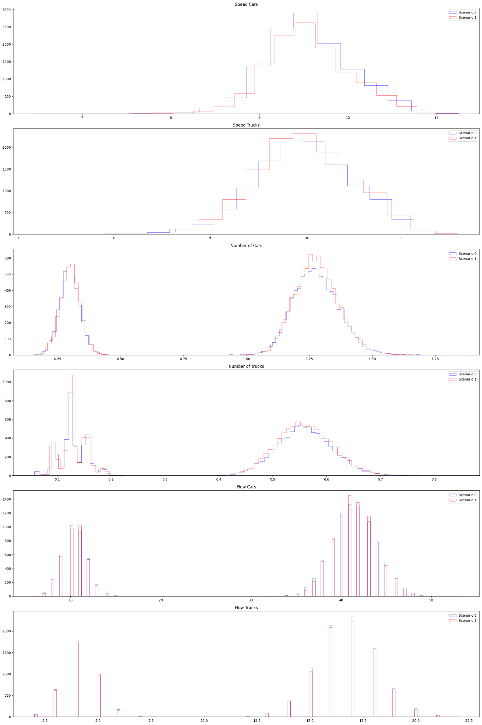

Medium Change | Elicoidale Upstream (d=6), qtree ewma (K=32)
No change detected.

Slide 44

Medium Change | Elicoidale Downstream (d=6), qtree ewma (K=32)
No change detected here?

Slide 45


Medium Change | Lungomare Canepa (d=6), qtree ewma (K=32)
No change detected here?

Slide 46


Medium Change | Via di Francia (d=3), qtree ewma (K=32)
Change detected around 2-3 months later.

Slide 47
Big Change
Big policy change between scenarios.
Scenario 0: basic scenario (with some ferry traffic)
Scenario 1: basic scenario plus some changes in the two aforementioned traffic lights and another one.
Gaussian noise (0 mean, 0.001 sigma) is added to the variables “flow cars” or “flow trucks” to deal with its discreteness.

Slide 48
Weekday Only

Slide 49


Big Change | All 4 segments (d=21), qtree ewma (K=32)
Change detected around 1 months later.

Slide 50


Big Change | Elicoidale Upstream (d=6), qtree ewma (K=32)
No change detected.

Slide 51

Big Change | Elicoidale Downstream (d=6), qtree ewma (K=32)
Change detected around 1 month later.

Slide 52


Big Change | Lungomare Canepa (d=6), qtree ewma (K=32)
Change detected around 2-3 months later.

Slide 53


Big Change | Via di Francia (d=3), qtree ewma (K=32)
Change detected around 2 weeks later, really easy to detect here.

Slide 54
Weekend Only

Slide 55


Big Change | All 4 segments (d=21), qtree ewma (K=32)
No change detected here.

Slide 56


Big Change | Elicoidale Upstream (d=6), qtree ewma (K=32)
No change detected here.

Slide 57

Big Change | Elicoidale Downstream (d=6), qtree ewma (K=32)
No change detected here?

Slide 58


Big Change | Lungomare Canepa (d=6), qtree ewma (K=32)
No change detected here.

Slide 59


Big Change | Via di Francia (d=3), qtree ewma (K=32)
No change detected here.

Slide 60
Mixture
Weekday (70%) + Weekend (30%)

Slide 61


Big Change | All 4 segments (d=21), qtree ewma (K=32)
Change detected after 2-4 months later

Slide 62


Big Change | Elicoidale Upstream (d=6), qtree ewma (K=32)
No change detected.

Slide 63

Big Change | Elicoidale Downstream (d=6), qtree ewma (K=32)
Change detected here after 2-3 months

Slide 64


Big Change | Lungomare Canepa (d=6), qtree ewma (K=32)
Change practically undetected.

Slide 65


Big Change | Via di Francia (d=3), qtree ewma (K=32)
Change detected in around 1 month.

Slide 66
Actuated Change
Big policy change between scenarios.
Scenario 0: basic scenario (with some ferry traffic)
Scenario 1: structural change in the network. Namely, the two traffic lights A and B are now actuated, which means that they adjust the green and red phases dynamically depending on the current traffic, instead of implementing a fixed phases program.
Gaussian noise (0 mean, 0.001 sigma) is added to the variables “flow cars” or “flow trucks” to deal with its discreteness.

Slide 67
Weekday Only

Slide 68


Actuated Change | All 4 segments (d=21), qtree ewma (K=32)
Change detected 1 week later.

Slide 69


Actuated Change | Elicoidale Upstream (d=6), qtree ewma (K=32)
No change detected.

Slide 70

Actuated Change | Elicoidale Downstream (d=6), qtree ewma (K=32)
Change detected instantly.

Slide 71


Actuated Change | Lungomare Canepa (d=6), qtree ewma (K=32)
Change detected around 2 weeks to 1 month later.

Slide 72


Actuated Change | Via di Francia (d=3), qtree ewma (K=32)
Change detected around 1 week later

Slide 73
Weekend Only

Slide 74


Actuated Change | All 4 segments (d=21), qtree ewma (K=32)
Changes detected after 2-4 months

Slide 75


Actuated Change | Elicoidale Upstream (d=6), qtree ewma (K=32)
No change detected here.

Slide 76

Actuated Change | Elicoidale Downstream (d=6), qtree ewma (K=32)
Changes detected after 2 weeks.

Slide 77


Actuated Change | Lungomare Canepa (d=6), qtree ewma (K=32)
No change detected here.

Slide 78


Actuated Change | Via di Francia (d=3), qtree ewma (K=32)
No change detected here.

Slide 79
Mixture
Weekday (70%) + Weekend (30%)

Slide 80


Actuated Change | All 4 segments (d=21), qtree ewma (K=32)
Change detected after 2 weeks.

Slide 81


Actuated Change | Elicoidale Upstream (d=6), qtree ewma (K=32)
No change detected.

Slide 82

Actuated Change | Elicoidale Downstream (d=6), qtree ewma (K=32)
Change detected instantly.

Slide 83


Actuated Change | Lungomare Canepa (d=6), qtree ewma (K=32)
Change detected in around 1 month

Slide 84


Actuated Change | Via di Francia (d=3), qtree ewma (K=32)
Change detected in around 1 month.

